Slide 1
Understanding BERT: From Basics to Depth

Slide 2
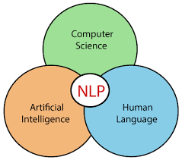
What is NLP?
Natural Language Processing (NLP) is a branch of AI that helps computers understand, interpret, and generate human language.

Slide 3
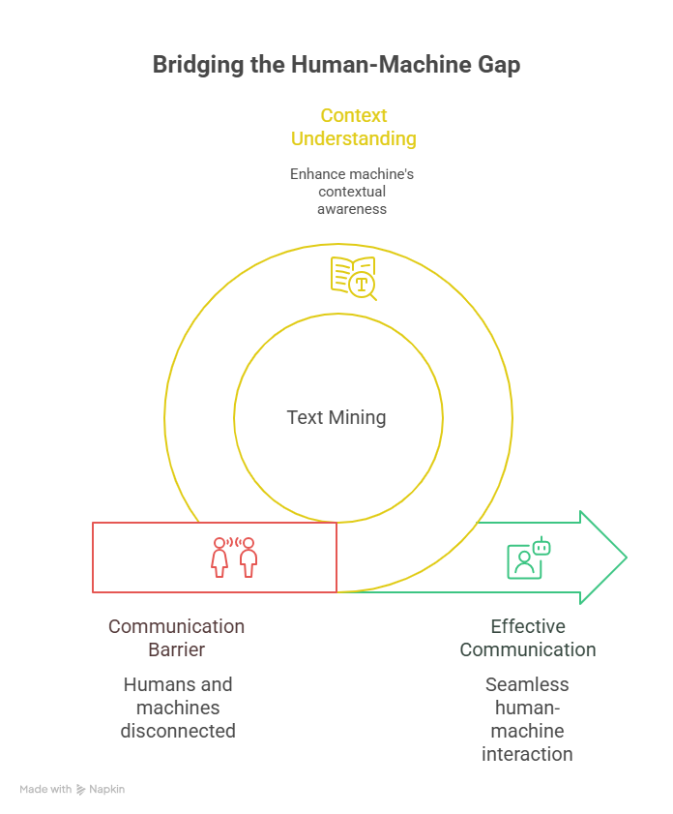
Why is NLP Important?

Slide 4
PA PA PAGLI..
import nltk
nltk.download('punkt_tab')
text = "Natural Language Processing is the foundation of modern AI. ChatGPT understands text amazingly well!"
print("Original Text:\n", text)
# -----------------------------
# 2. Tokenization
# -----------------------------
from nltk.tokenize import word_tokenize
tokens = word_tokenize(text)
print("\nTokens:", tokens)
Text Cleaning: Preparing raw text by removing unwanted characters, punctuation, special symbols, or numbers, and converting everything to lowercase.
Example :
"Mayur understands TEXT!!! 😊"
"Mayur understands TEXT"
Tokenization: Splitting text into smaller units (tokens), usually words or sentences.
Example: Hanuman is powerful." → ["Hanuman", "is", "powerful"]

Slide 5
One Hot Encoding
from sklearn.preprocessing import OneHotEncoder
import numpy as np
# Sample data
corpus = ['dog', 'cat', 'dog', 'fish']
# Reshape data to fit the model
corpus = np.array(corpus).reshape(-1, 1)
# One-hot encode the data
onehot_encoder = OneHotEncoder()
onehot_encoded = onehot_encoder.fit_transform(corpus)
print(onehot_encoded)
#output
[[0. 1. 0.]
[1. 0. 0.]
[0. 1. 0.]
[0. 0. 1.]]
It can be identified as one of the simplest forms of representing words numerically. Each word is represented as a binary vector with the length of the entire vocabulary. The vector has a “1” in the position corresponding to the word’s index and “0” elsewhere.
Pro’s: Simple, interpretable.
Con’s: High dimensionality, doesn’t capture semantic relationships.

Slide 6
Bag of Words(BoW)
from sklearn.feature_extraction.text import CountVectorizer
# Sample data
corpus = [
'This is the first document.',
'This document is the second document.',
'And this is the third one.',
'Is this the first document?',
]
# Initialize the CountVectorizer
vectorizer = CountVectorizer()
# Fit and transform the corpus
X = vectorizer.fit_transform(corpus)
print(X.toarray())
print(vectorizer.get_feature_names_out())
#output of the above code
[[0 1 1 1 0 0 1 0 1]
[0 2 0 1 0 1 1 0 1]
[1 0 0 1 1 0 1 1 1]
[0 1 1 1 0 0 1 0 1]]
['and' 'document' 'first' 'is' 'one' 'second' 'the' 'third' 'this']
Bag-of-Words (BOW) is a simple technique in Natural Language Processing (NLP) for representing text documents as numerical vectors. The idea is to treat each document as a bag, or a collection, of words, and then count the frequency of each word in the document. It does not consider the order of words but provides a straightforward way to convert text into vectors.
Pros: Simple, capture word importance based on frequency
Cons: Ignores word order and context.

Slide 7
TF-IDF (Term Frequency-Inverse Document Frequency)
TF-IDF is an improvement over BoW, which considers the importance of words by reducing the weight of common words while increasing the weight of rare ones. The idea behind TF-IDF is to calculate the importance of a word in a document by considering two factors:
Term Frequency (TF): This measures how frequently a term appears in a document. The higher the frequency, the more important the term is assumed to be to that document.
Inverse Document Frequency (IDF): It is a measure of how important a term is across all documents in the corpus. It’s based on the intuition that terms that appear in many documents are less informative than terms that appear in fewer documents.
TF-IDF = TF * IDF
The TF-IDF score is used to rank the importance of words in a document, with higher scores indicating more important words.
Pros: Considers both term frequency and rarity.
Cons: Still doesn’t capture semantic relationships.
from sklearn.feature_extraction.text import TfidfVectorizer
# Sample data
corpus = [
'This is the first document.',
'This document is the second document.',
'And this is the third one.',
'Is this the first document?',
]
# Initialize the TfidfVectorizer
vectorizer = TfidfVectorizer()
# Fit and transform the corpus
X = vectorizer.fit_transform(corpus)
print(X.toarray())
print(vectorizer.get_feature_names_out())

Slide 8
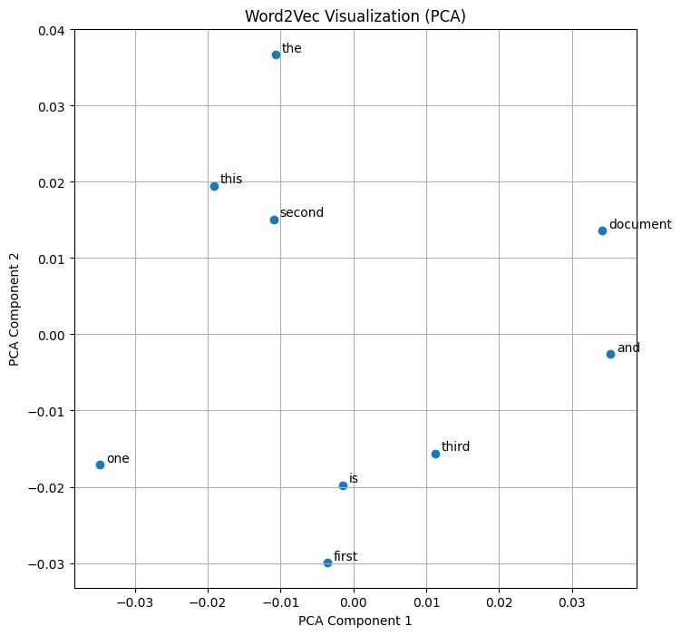
Word 2 vector
!pip install gensim
from gensim.models import Word2Vec
# Sample data
sentences = [
['this', 'is', 'the', 'first', 'document'],
['this', 'document', 'is', 'the', 'second', 'document'],
['and', 'this', 'is', 'the', 'third', 'one'],
['is', 'this', 'the', 'first', 'document']
]
# Initialize the Word2Vec model
model = Word2Vec(sentences, vector_size=100, window=5, min_count=1, workers=4)
# Train the model
model.train(sentences, total_examples=len(sentences), epochs=10)
# Get vector for a word
print(model.wv['document'])

Slide 9
Word2Vec, GloVe, FastText
Continuous Bag-of-Words (CBOW): Predicts the target word given its surrounding context words.
Skip-Gram: Predicts the surrounding context words given a target word.
Pros: Captures semantic relationships between words, lower dimensionality than classical methods. Cons: Requires training on a large corpus, doesn’t handle out-of-vocabulary (OOV) words well.
Word2Vec is a neural network-based model that generates dense vector representations of words.
The basic idea behind Word2Vec is to train a neural network to predict the context words given a target word, and then use the resulting vector representations to capture the semantic meaning of the words.
It captures semantic relationships between words using two main approaches: Continuous Bag of Words (CBOW) and Skip-gram.

Slide 10
GloVe (Global Vectors for Word Representation)
import gensim.downloader as api
# Download pre-trained GloVe model (choose the size you need - 50, 100, 200, or 300 dimensions)
glove_vectors = api.load("glove-wiki-gigaword-100") # Example: 100-dimensional GloVe
# Get word vectors (embeddings)
word1 = "king"
word2 = "queen"
vector1 = glove_vectors[word1]
vector2 = glove_vectors[word2]
# Compute cosine similarity between the two word vectors
similarity = glove_vectors.similarity(word1, word2)
print(f"Word vectors for '{word1}': {vector1}")
print(f"Word vectors for '{word2}': {vector2}")
print(f"Cosine similarity between '{word1}' and '{word2}': {similarity}")

Slide 11
FastText
Subword Information: Unlike traditional word embedding models (e.g., Word2Vec, Glove) that treat each word as a distinct unit, FastText considers words as a bag of character n-grams (subwords). An n-gram is a contiguous sequence of n characters.
Efficient Handling of Out-of-Vocabulary (OOV) Words: By utilizing subword information, FastText can generate meaningful representations for rare words or words not seen during training. This is particularly useful for morphologically rich languages (e.g., agglutinative languages) and in situations where the vocabulary is constantly evolving.
Fast Training and Inference: FastText employs two key techniques to achieve high speed:
Hierarchical Softmax: A hierarchical tree structure is used to represent the output labels, significantly reducing the computational complexity of the softmax function during training and prediction.
Negative Sampling: Only a small subset of the output labels (negative samples) are updated during training, making updates much faster.
Pros: Handles OOV words, captures morphological information.
Cons: Higher dimensionality than Word2Vec.

Slide 12
Fast Text
from gensim.models import FastText
# Sample data
sentences = [
['this', 'is', 'the', 'first', 'document'],
['this', 'document', 'is', 'the', 'second', 'document'],
['and', 'this', 'is', 'the', 'third', 'one'],
['is', 'this', 'the', 'first', 'document']
]
# Initialize the FastText model
model = FastText(sentences, vector_size=100, window=5, min_count=1, workers=4)
# Train the model
model.train(sentences, total_examples=len(sentences), epochs=10)
# Get vector for a word
print(model.wv['document'])

Slide 13
ELMo (Embeddings from Language Models)
ELMo is a deep contextualized word representation that models both complex characteristics of word use (e.g., syntax and semantics) and how these uses vary across linguistic contexts (e.g., to model polysemy). ELMo generates context-sensitive embeddings using deep bi-directional LSTM models. It provides different embeddings for words based on their context.
Key Features of ELMo:
1. Contextualized Representations: ELMo embeddings vary depending on the context in which a word appears. This is different from traditional embeddings like Word2Vec or GloVe, which provide a single representation for each word regardless of context.
2. Deep Representations: ELMo uses deep bidirectional LSTM networks to generate embeddings, capturing complex syntactic and semantic information.
3. Layer-wise Representations: ELMo combines representations from all the layers of the biLSTM, which allows it to capture different types of information at different layers.
Pros: Contextualized Embeddings, Bi-directional Context.
Cons: Complexity and Size, Fixed context window.

Slide 14
ELMo
import tensorflow as tf
import tensorflow_hub as hub
# Load pre-trained ELMo model from TensorFlow Hub
elmo = hub.load("https://tfhub.dev/google/elmo/3")
# Sample data
sentences = ["This is the first document.", "This document is the second document."]
def elmo_vectors(sentences):
embeddings = elmo.signatures['default'](tf.constant(sentences))['elmo']
return embeddings
# Get ELMo embeddings
elmo_embeddings = elmo_vectors(sentences)
print(elmo_embeddings)

Slide 15
Why: Students should see why something like BERT was even needed.

Slide 16
Transition into Deep Learning for NLP
Up to now, most NLP tasks relied on rule-based systems or classical machine learning approaches like Naïve Bayes, SVMs, or logistic regression. These methods often depend on hand-crafted features (e.g., bag-of-words, TF-IDF, n-grams) and work well for smaller datasets and simple problems. However, they struggle when it comes to:
Capturing context and meaning in long sequences of text.
Handling ambiguity (e.g., “bank” as a riverbank vs. financial bank).
Scaling to large and diverse text corpora.

Slide 17
Deep Learning
This is where Deep Learning made a breakthrough. By learning representations automatically from raw text rather than relying only on handcrafted features, deep neural networks brought significant improvements in tasks like machine translation, sentiment analysis, and question answering.
https://playground.tensorflow.org/

Slide 18
Key reasons for the shift:
Word Embeddings (Word2Vec, GloVe, FastText) → Represent words in dense vector space where semantic meaning is preserved.
Neural Networks for Sequences → RNNs, LSTMs, and GRUs can capture word order and sequential context better than bag-of-words.
Attention Mechanisms & Transformers → Allow models to focus on relevant parts of a sequence and process text in parallel, leading to powerful models like BERT and GPT.

Slide 19
This initializes the Word2Vec model.
The parameters mean:
sentences: Your training data (a list of tokenized sentences).
Example: [["I", "like", "cats"], ["cats", "like", "milk"]].
vector_size=100: The dimension of the word embeddings (each word → a 100-dimensional vector).
Larger size → captures more nuance, but needs more data.
window=5: Context window size. The model will look 5 words before and 5 words after a given word to learn relationships.
Example: In sentence "I like cats and dogs", with window=2, when training on "cats", the context words are "I", "like", "and", "dogs".
min_count=1: Ignores words that appear fewer than min_count times. Here 1 means keep all words, even very rare ones. (Often set to 5 in real datasets to ignore noise.)
workers=4: Number of CPU threads to use in training (parallelization). More workers = faster training.

Slide 20
GloVe (Global Vectors for Word Representation)
GloVe is an unsupervised learning algorithm for obtaining vector representations for words. It aims to capture both global word co-occurrence statistics and local context window-based information (like Word2Vec) to create high-quality word vectors.
The core idea is that the ratios of word-word co-occurrence probabilities encode meaningful semantic relationships.
For example, consider the words “ice” and “steam” and their co-occurrence probabilities with other words like “solid” and “gas.” The ratio P(solid | ice) / P(solid | steam) would be high, indicating a stronger association between "ice" and "solid" compared to "steam" and "solid." GloVe leverages these ratios to learn word vectors.
Pros: Captures both global and local context, faster training than Word2Vec.
Cons: Similar to Word2Vec in terms of OOV words.

Slide 21
RNNs, LSTMs, GRUs → how they capture sequential context.
An RNN is like a person with a short memory – it remembers what just happened but quickly forgets things from a long time ago. For example, if you tell them a story and then ask a question about something you said much earlier, they probably won’t recall it well.
An LSTM is like a person who takes notes while listening to a story. They can choose what to write down, what to ignore, and what to erase later. Because of these “notes,” they can remember important details even if they happened a long time ago.
A GRU is like a person who also takes notes but in a simpler way, using fewer rules. They don’t keep as many details as the LSTM, but they are quicker and still remember the important parts of the story.

Slide 22
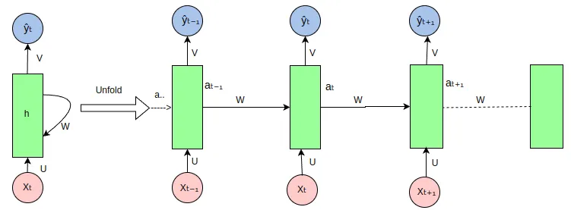
RNN
The RNN takes an input vector X and the network generates an output vector y by scanning the data sequentially from left to right, with each time step updating the hidden state and producing an output.
It shares the same parameters across all time steps.
A recurrent neural network (RNN) is a deep learning model that is trained to process and convert a sequential data input into a specific sequential data output.
Sequential data is data—such as words, sentences, or time-series data—where sequential components interrelate based on complex semantics and syntax rule

Slide 23
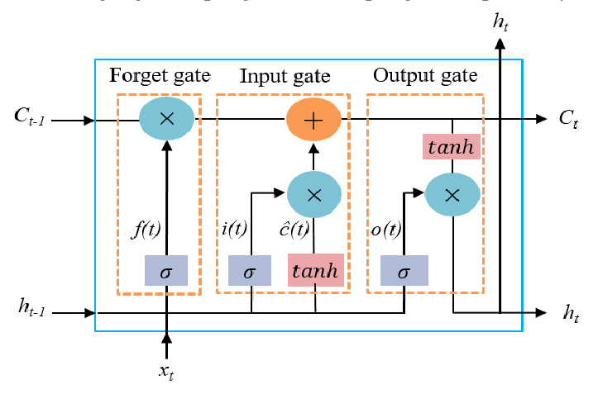
LSTM
An LSTM (Long Short Term Memory) architecture uses memory cells and three gates (forget gate, input gate, and output gate) to selectively retain or discard information over time, enabling it to learn long-term dependencies in sequential data
Unlike a traditional RNN, which has a simple structure of input, hidden state, and output, an LSTM has a more complex structure with additional memory cells and gates that allow it to selectively remember or forget information from previous time steps.

Slide 24
Problems: long-term dependency, slow training, no bidirectionality.

Slide 25

Long-term dependency
Imagine you are listening to a 2-hour story. At the end, someone asks: “What was the character’s name at the beginning?”
A simple RNN is like a person with a weak memory → it forgets details from long ago.
That’s the long-term dependency problem → the network struggles to connect far-away pieces of information (e.g., remembering “France” when predicting “I speak French”).

Slide 26
Slow training
RNNs read a story one word at a time and update memory step by step.
This means they cannot be parallelized easily (unlike CNNs or Transformers that can read multiple parts at once).
Result → Training takes longer, especially with large datasets or long sequences.

Slide 27
No bidirectionality
A normal RNN only reads text from left to right (past → future).
But sometimes, you also need to know the future context.
Example: In the sentence “I went to the bank to deposit money”, the word bank meaning becomes clear only after reading “money”.
A basic RNN can’t look ahead → it only knows the past, not the future.
That’s why Bidirectional RNNs/LSTMs were introduced, so the model reads both backward and forward.

Slide 28
sentence prediction example to show how RNNs “forget” context in long sequences.

Slide 29
BERT

Slide 30
Introduction
BERT is a transformer-based model that generates context-aware embeddings by considering the entire sentence bidirectionally (i.e., both left-to-right and right-to-left).
Unlike traditional word embeddings like Word2Vec or GloVe, which generate a single representation for each word, BERT produces different embeddings for each word based on its context.
Notes:
https://medium.com/@harsh.vardhan7695/a-comprehensive-guide-to-word-embeddings-in-nlp-ee3f9e4663ed

Slide 31
Key Features of BERT:
Encoder: The encoder is the main component of the BERT architecture, consisting of multiple transformer encoder layers.
Each encoder layer has a multi-head self-attention mechanism, which allows the model to attend to different positions in the input sequence when encoding a specific token.
The self-attention mechanism is bidirectional, meaning that the encoding of a token can attend to both left and right context in the sequence.
Each encoder layer also has a position-wise feed-forward network, which applies non-linear transformations to the output of the self-attention mechanism.

Slide 32
Key Features of BERT:
Pre-trained on Large Corpus: BERT is pre-trained on a large corpus of unlabeled text using two main objectives:
a. Masked Language Modeling (MLM): In this task, some tokens in the input sequence are randomly masked (replaced with a [MASK] token), and the model is trained to predict the masked tokens based on the context.
b. Next Sentence Prediction (NSP): In this task, the model is trained to predict whether two input sentences are consecutive in the original text or not.

Slide 33
Key Features of BERT:
Fine-tuning: After pre-training, BERT can be fine-tuned for specific NLP tasks by adding a task-specific output layer on top of the encoder.
The parameters of the pre-trained BERT model are fine-tuned using labeled data for the target task, while the output layer is trained from scratch.
This transfer learning approach allows BERT to leverage its pre-trained knowledge and adapt to new tasks with relatively small amounts of labeled data.

Slide 34
Pros and Cons
Pros: Pre-training and Fine-tuning, Contextualized Embeddings, Bi-directional Context.
Cons: Complexity and Size, Complexity, Inference Time.

Slide 35
from transformers import BertTokenizer, BertModel
import torch
# Load pre-trained BERT model and tokenizer
tokenizer = BertTokenizer.from_pretrained('bert-base-uncased')
model = BertModel.from_pretrained('bert-base-uncased')
# Sample data
sentence = "This is the first document."
# Tokenize input
inputs = tokenizer(sentence, return_tensors='pt')
# Get embeddings
with torch.no_grad():
outputs = model(**inputs)
embeddings = outputs.last_hidden_state
print(embeddings)
Notes:
https://medium.com/@harsh.vardhan7695/a-comprehensive-guide-to-word-embeddings-in-nlp-ee3f9e4663ed

Slide 36
Introduce Transformers (The Core)
Attention mechanism: Key, Query, Value idea (with simple analogy: “paying attention in a classroom”).
Self-Attention and Multi-Head Attention.
Encoder vs Decoder in the Transformer architecture.
Visuals: Draw the Transformer encoder block step by step.
Why: BERT is just “stacked Transformer encoders” — students must get this first.

Slide 37
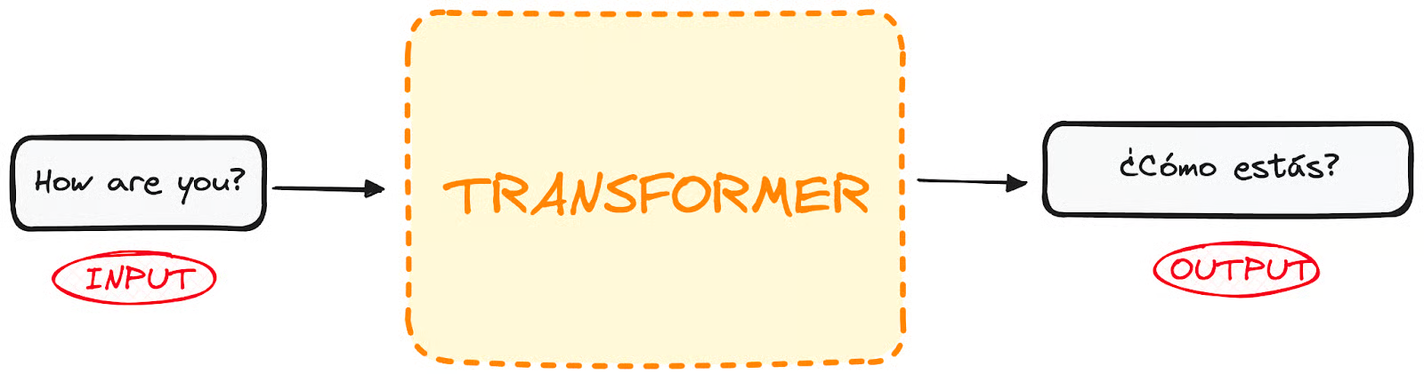
What Are Transformers?
Transformers were first developed to solve the problem of sequence transduction, or neural machine translation, which means they are meant to solve any task that transforms an input sequence to an output sequence. This is why they are called “Transformers”.

Slide 38
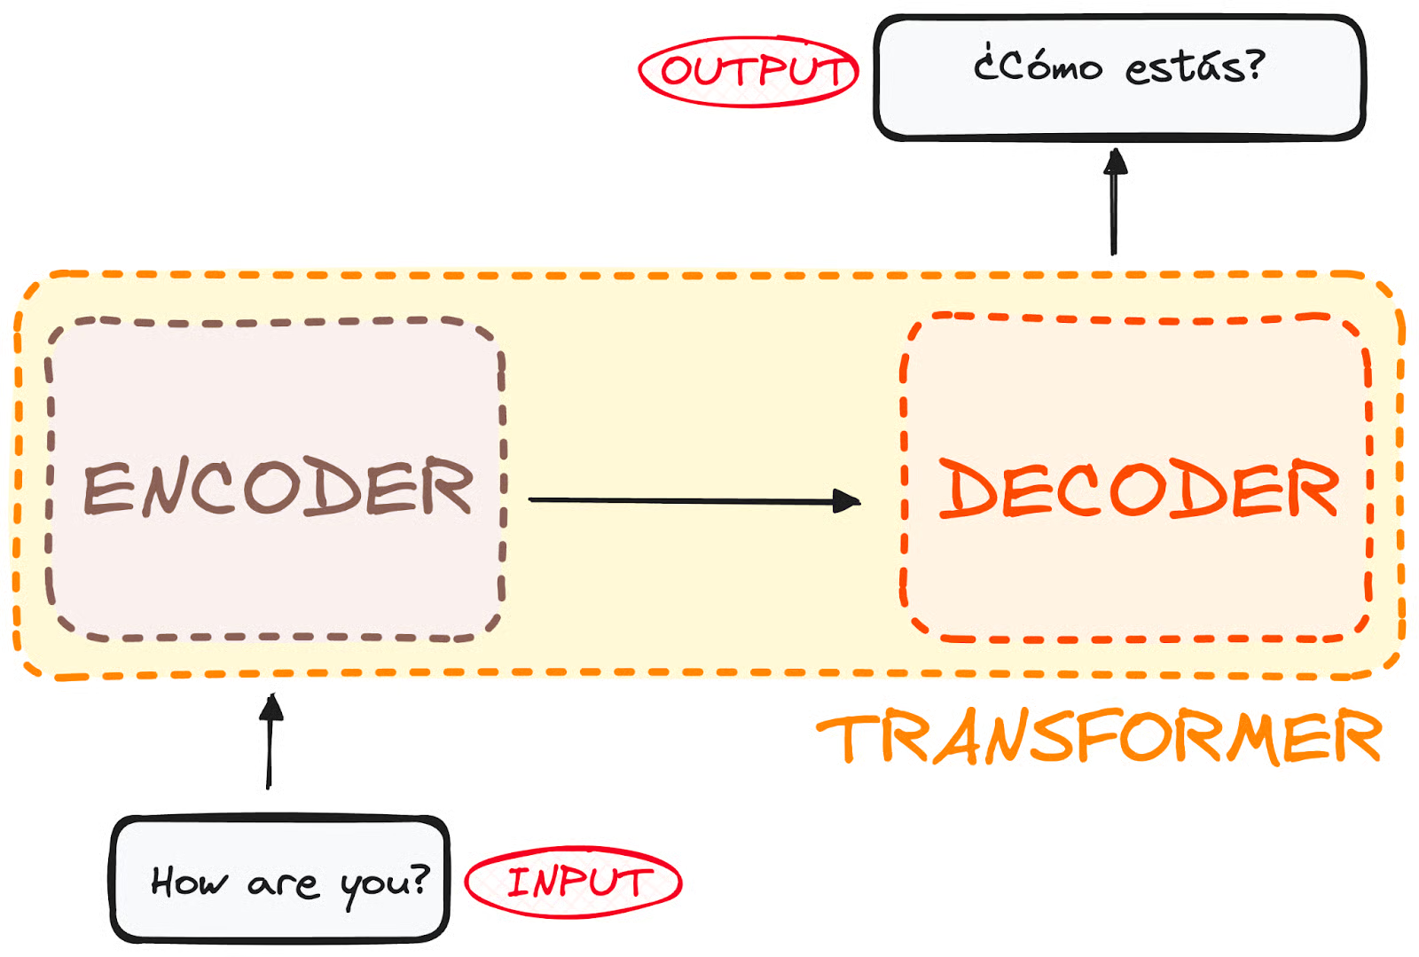
In side of Transformer
If we dive a little bit, we observe that this black box is composed of two main parts:
The encoder takes in our input and outputs a matrix representation of that input. For instance, the English sentence “How are you?”
The decoder takes in that encoded representation and iteratively generates an output. In our example, the translated sentence “¿Cómo estás?”

Slide 39
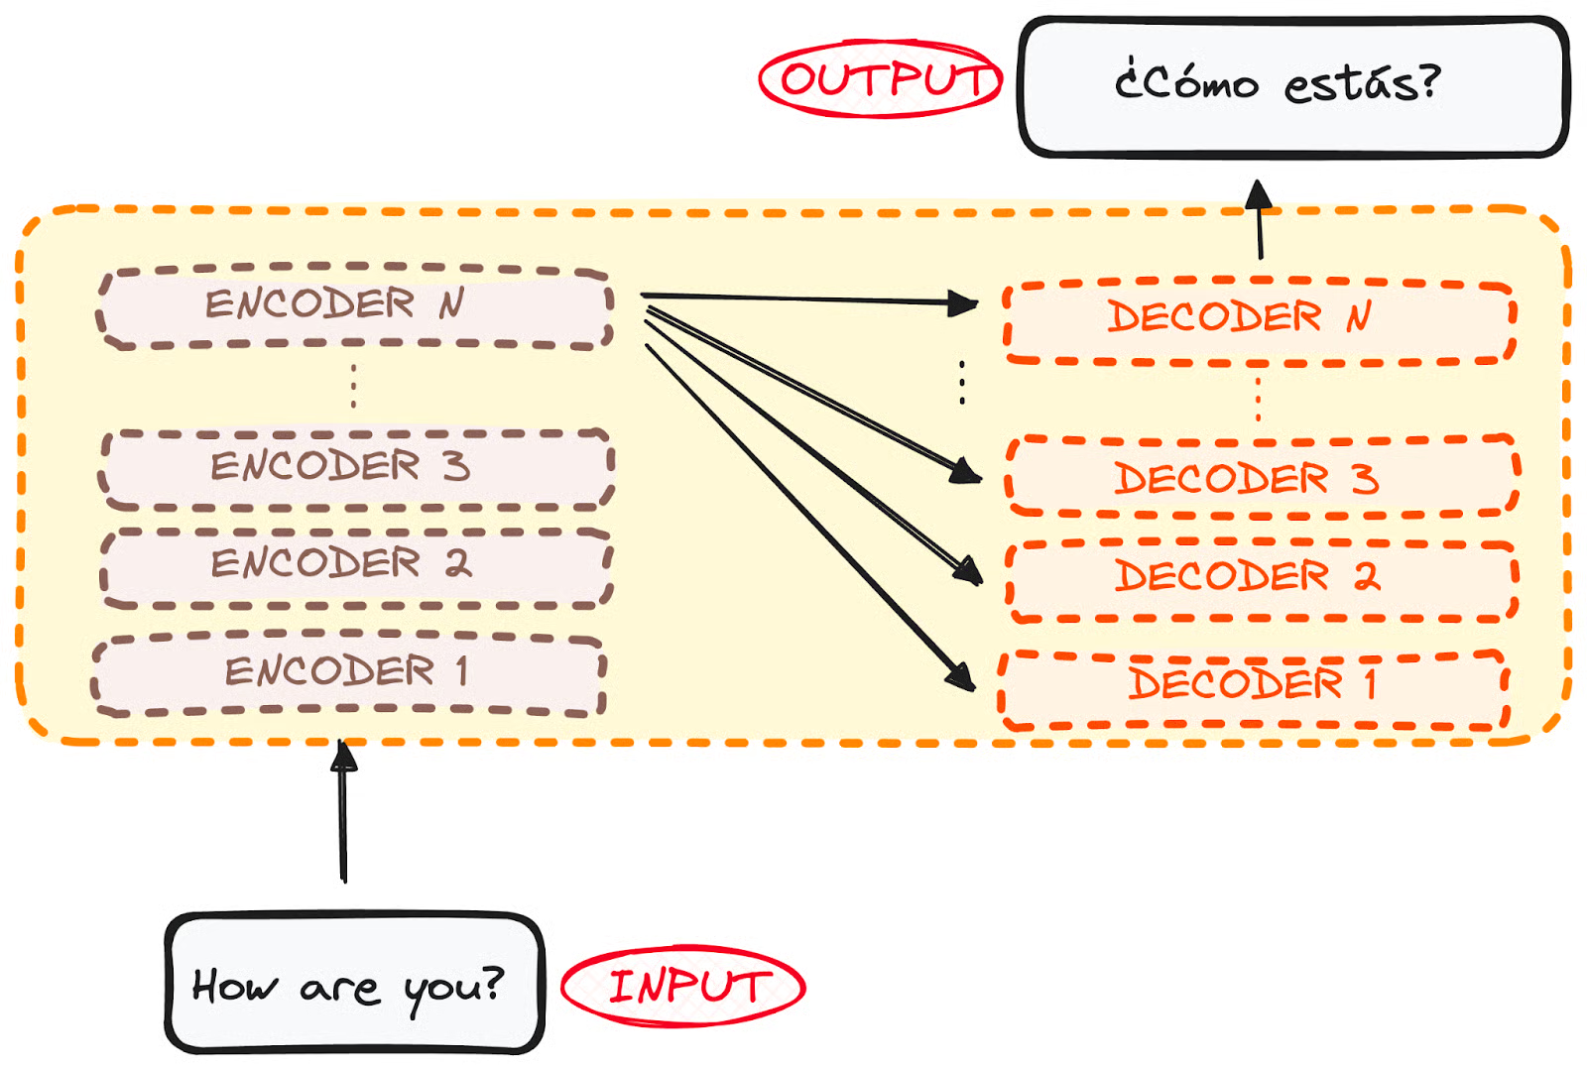
However, both the encoder and the decoder are actually a stack with multiple layers (same number for each).
All encoders present the same structure, and the input gets into each of them and is passed to the next one.
All decoders present the same structure as well and get the input from the last encoder and the previous decoder.
The original architecture consisted of 6 encoders and 6 decoders, but we can replicate as many layers as we want. So let’s assume N layers of each.
Notes:
https://www.datacamp.com/tutorial/how-transformers-work

Slide 40
So now that we have a generic idea of the overall Transformer architecture, let’s focus on both Encoders and Decoders to understand better their working flow:

Slide 41
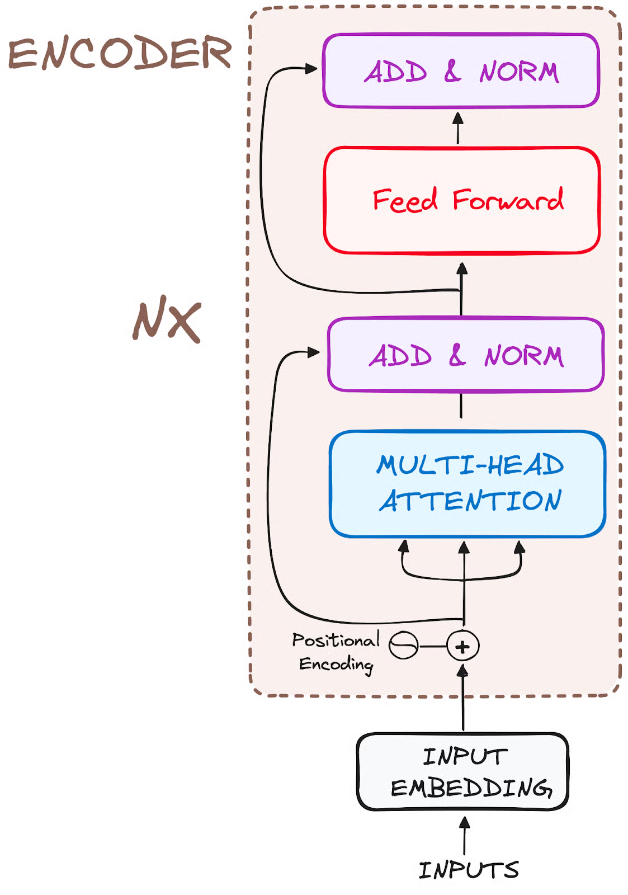
The Encoder WorkFlow
The encoder is a fundamental component of the Transformer architecture.
The primary function of the encoder is to transform the input tokens into contextualized representations.
Unlike earlier models that processed tokens independently, the Transformer encoder captures the context of each token with respect to the entire sequence.
Its structure composition consists as follows:

Slide 42
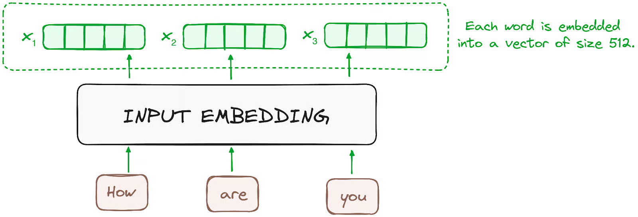
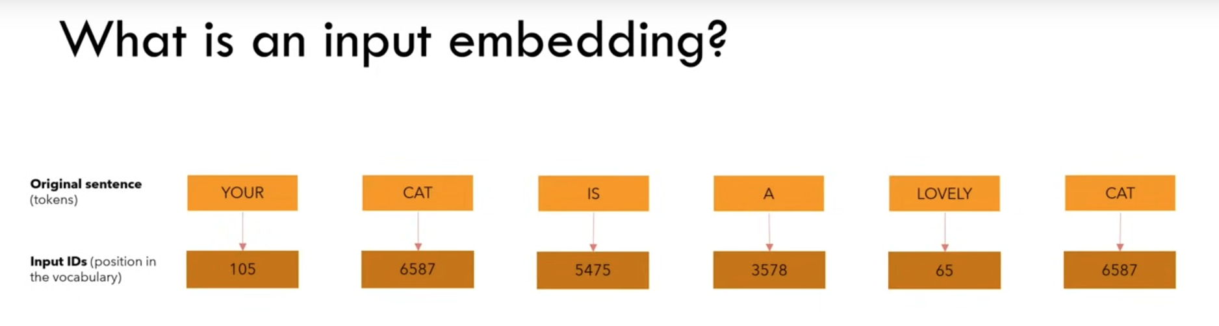
STEP 1 - Input Embeddings
The embedding only happens in the bottom-most encoder.
The encoder begins by converting input tokens - words or subwords - into vectors using embedding layers.
These embeddings capture the semantic meaning of the tokens and convert them into numerical vectors.
All the encoders receive a list of vectors, each of size 512 (fixed-sized).
In the bottom encoder, that would be the word embeddings, but in other encoders, it would be the output of the encoder that’s directly below them.

Slide 43
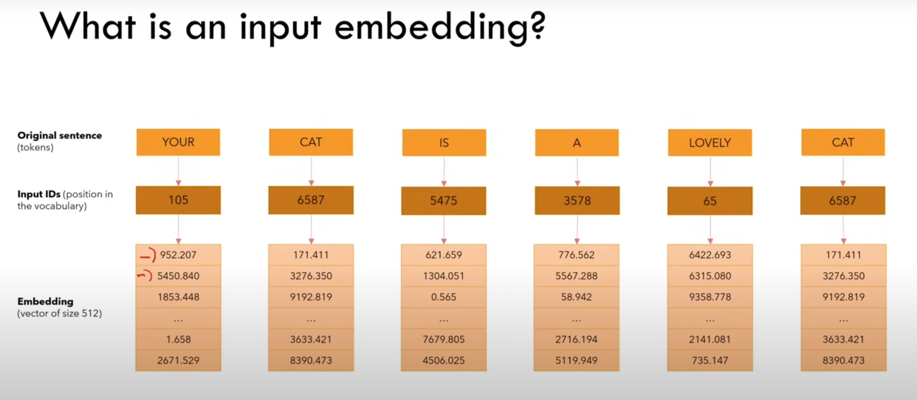

Slide 44
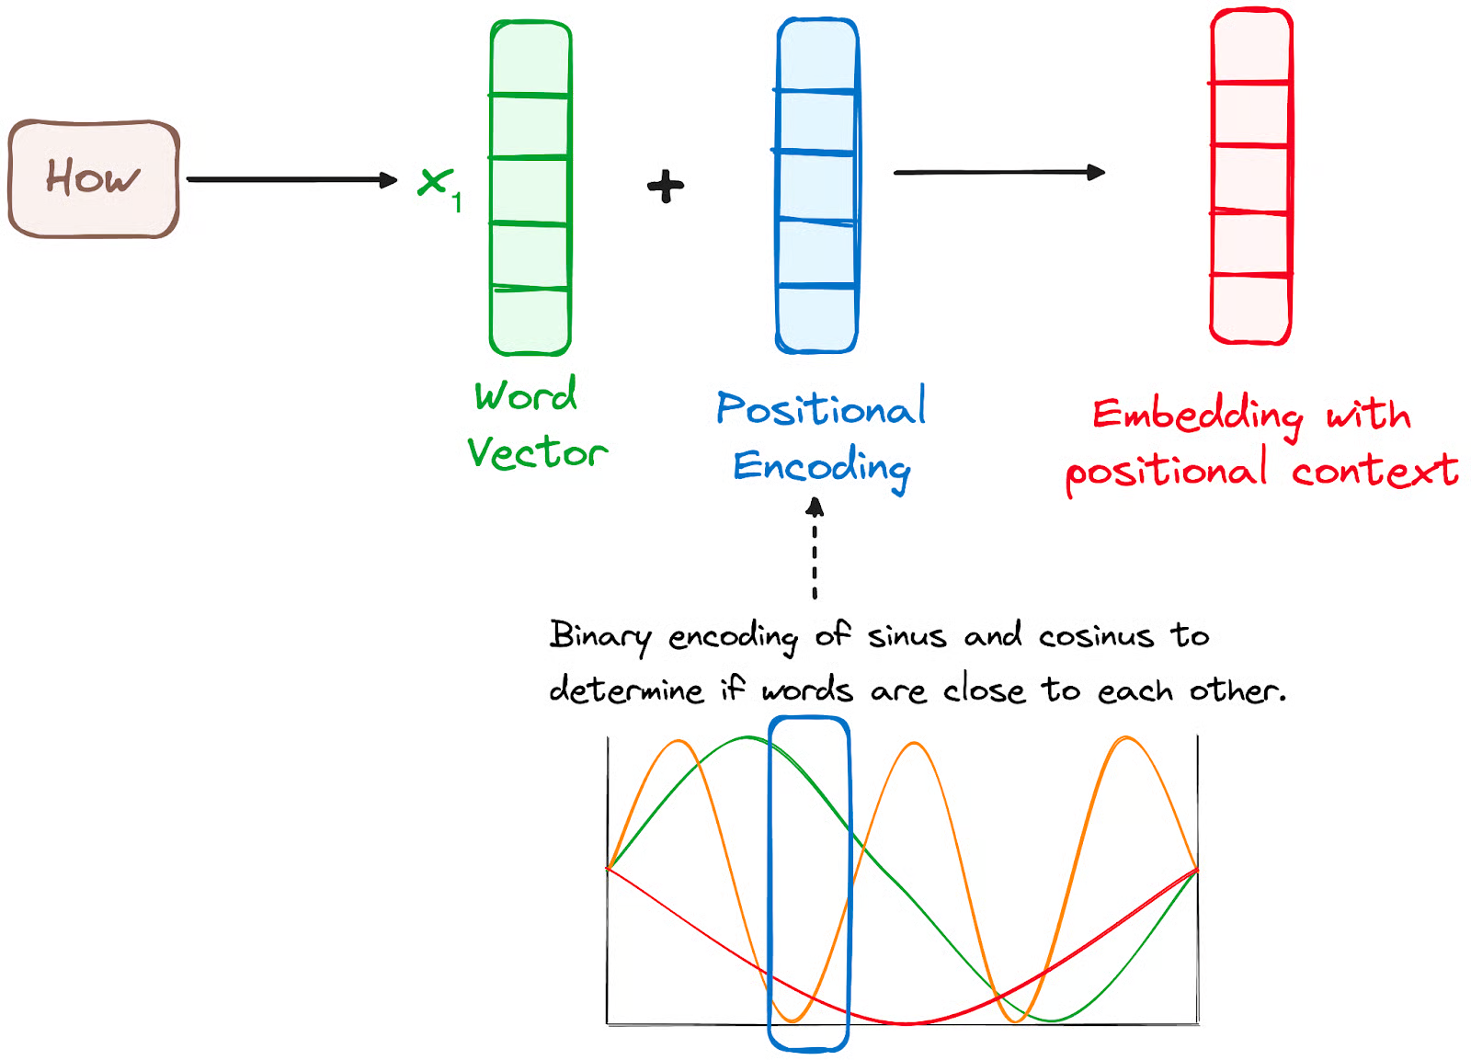
STEP 2 - Positional Encoding
Since Transformers do not have a recurrence mechanism like RNNs, they use positional encodings added to the input embeddings to provide information about the position of each token in the sequence.
This allows them to understand the position of each word within the sentence.
To do so, the researchers suggested employing a combination of various sine and cosine functions to create positional vectors, enabling the use of this positional encoder for sentences of any length.
In this approach, each dimension is represented by unique frequencies and offsets of the wave, with the values ranging from -1 to 1, effectively representing each position.

Slide 45
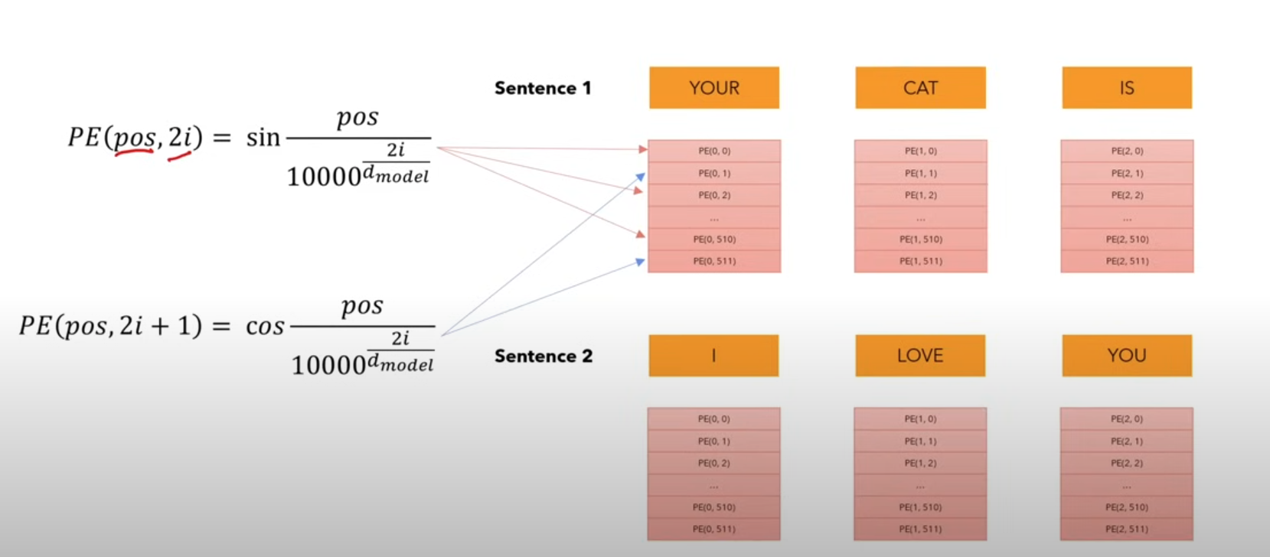

Slide 46
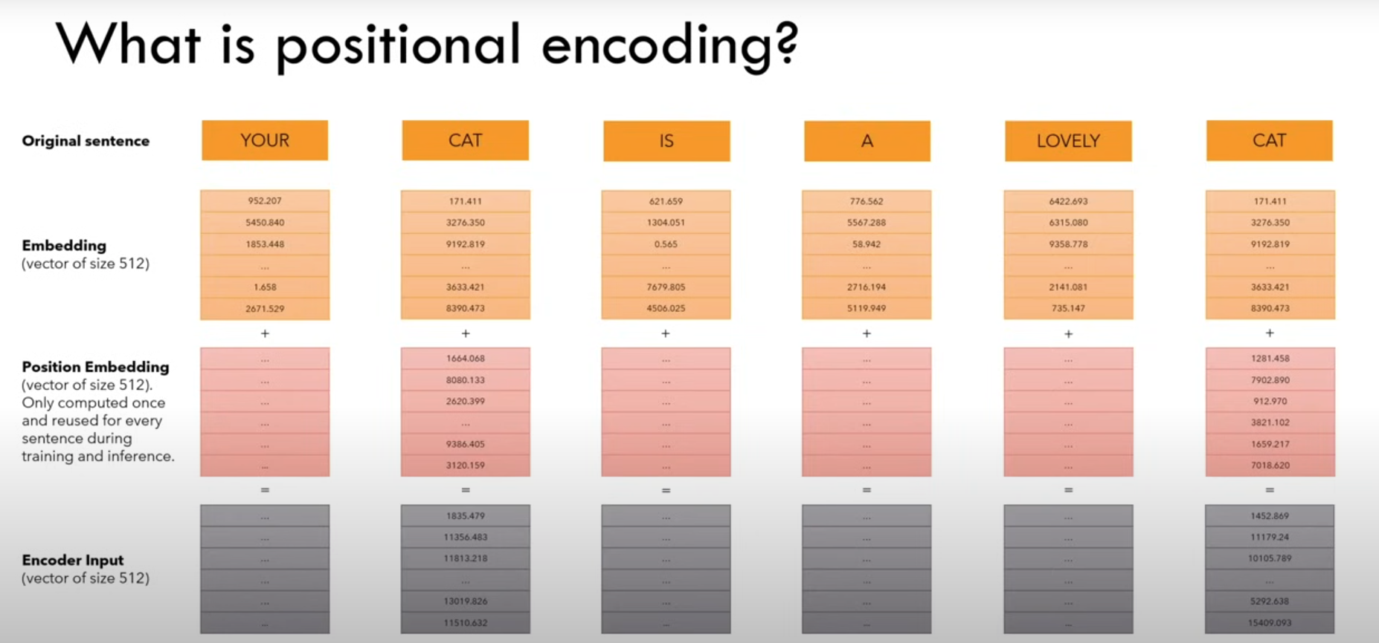

Slide 47
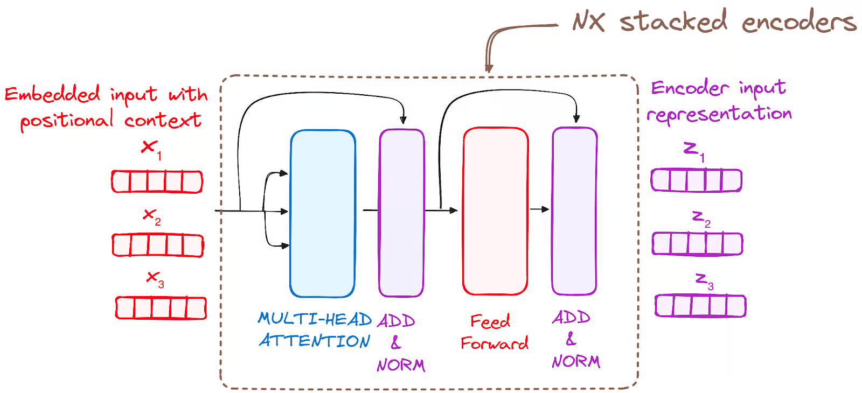
STEP 3 - Stack of Encoder Layers
The Transformer encoder consists of a stack of identical layers (6 in the original Transformer model).
The encoder layer serves to transform all input sequences into a continuous, abstract representation that encapsulates the learned information from the entire sequence. This layer comprises two sub-modules:
A multi-headed attention mechanism.
A fully connected network.
Additionally, it incorporates residual connections around each sublayer, which are then followed by layer normalization.

Slide 48
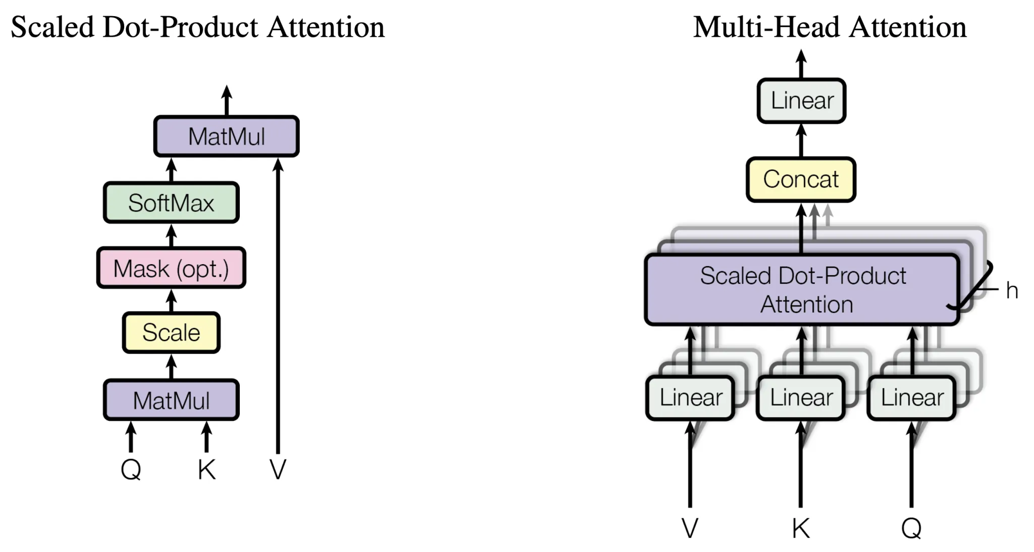
STEP 3.1 Multi-Headed Self-Attention Mechanism
In the encoder, the multi-headed attention utilizes a specialized attention mechanism known as self-attention.
This approach enables the models to relate each word in the input with other words.
For instance, in a given example, the model might learn to connect the word “are” with “you”.

Slide 49
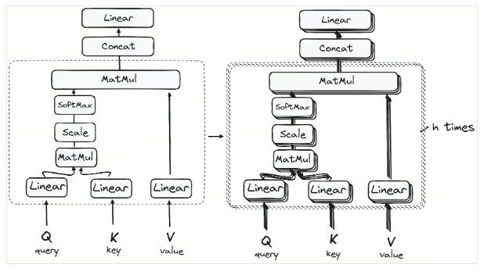

Self Attention
This first Self-Attention module enables the model to capture contextual information from the entire sequence. Instead of performing a single attention function, queries, keys and values are linearly projected h times.
On each of these projected versions of queries, keys and values the attention mechanism is performed in parallel, yielding h-dimensional output values.
Notes:
https://medium.com/@fernandopalominocobo/demystifying-visual-transformers-with-pytorch-understanding-multihead-attention-part-3-3-d22e81a1cb16
https://aiml.com/what-is-multi-head-attention-and-how-does-it-improve-model-performance-over-single-attention-head/

Slide 50
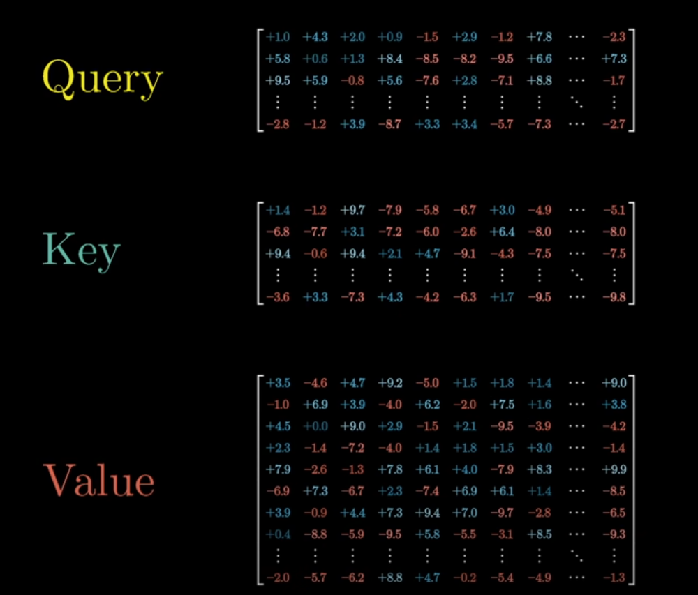
This mechanism allows the encoder to focus on different parts of the input sequence as it processes each token. It computes attention scores based on:
A query is a vector that represents a specific word or token from the input sequence in the attention mechanism.
A key is also a vector in the attention mechanism, corresponding to each word or token in the input sequence.
Each value is associated with a key and is used to construct the output of the attention layer. When a query and a key match well, which basically means that they have a high attention score, the corresponding value is emphasized in the output.

Slide 51
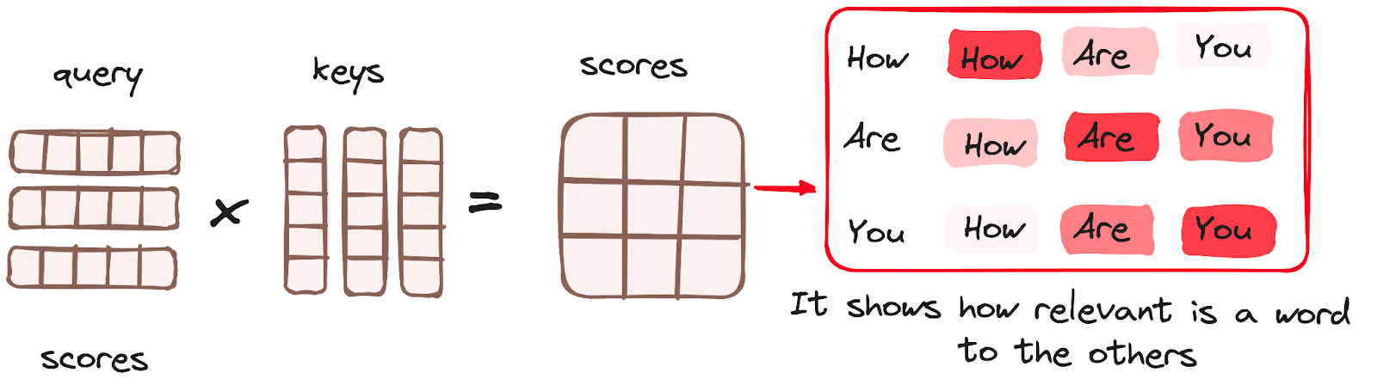
This process effectively maps the queries to their corresponding keys.
Once the query, key, and value vectors are passed through a linear layer, a dot product matrix multiplication is performed between the queries and keys, resulting in the creation of a score matrix.
The score matrix establishes the degree of emphasis each word should place on other words. Therefore, each word is assigned a score in relation to other words within the same time step. A higher score indicates greater focus.

Slide 52
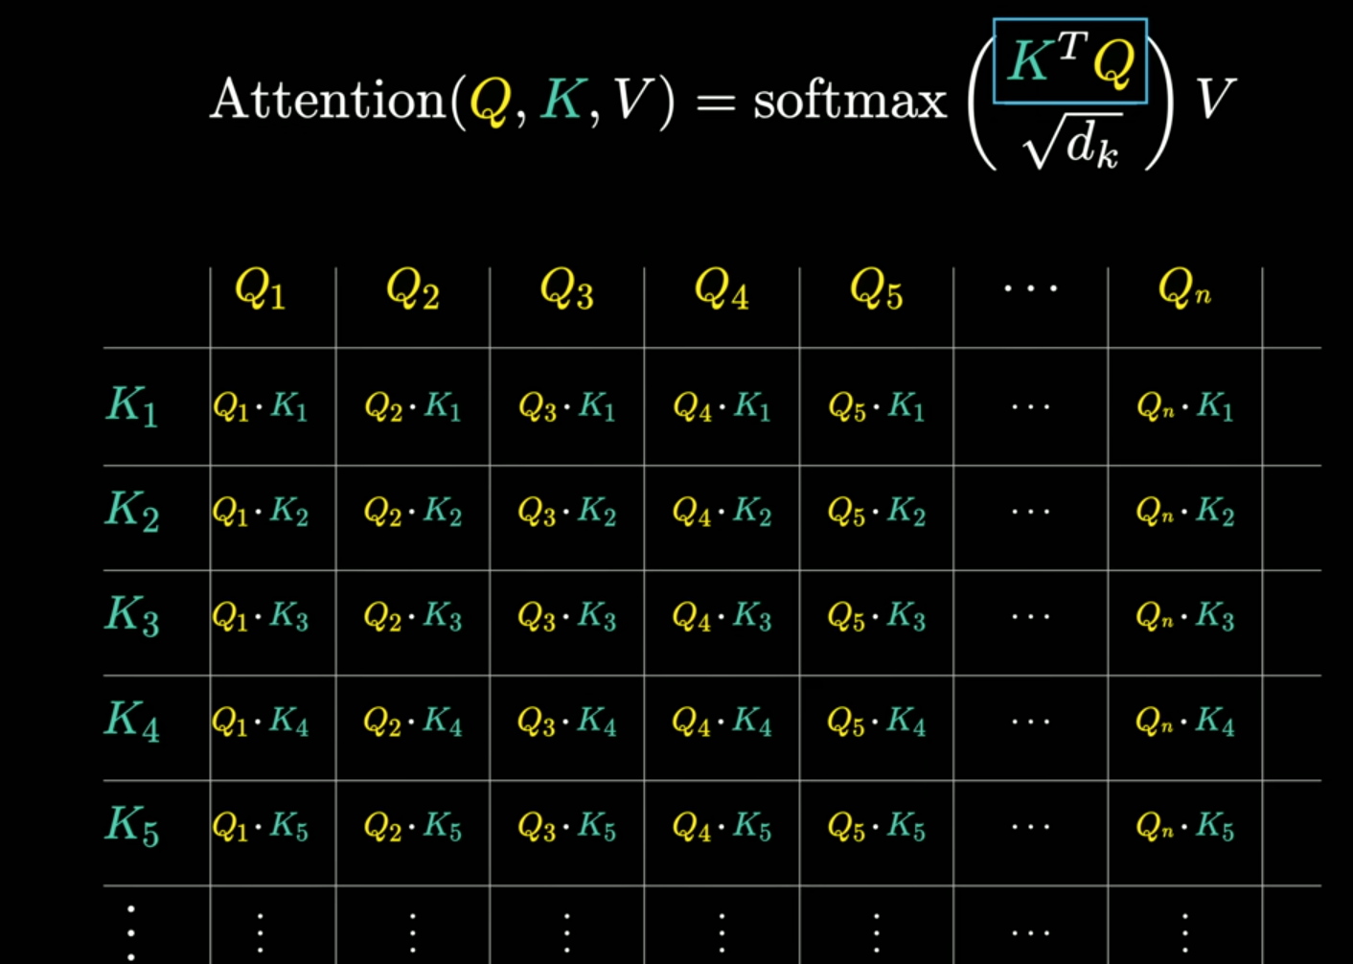

Slide 53
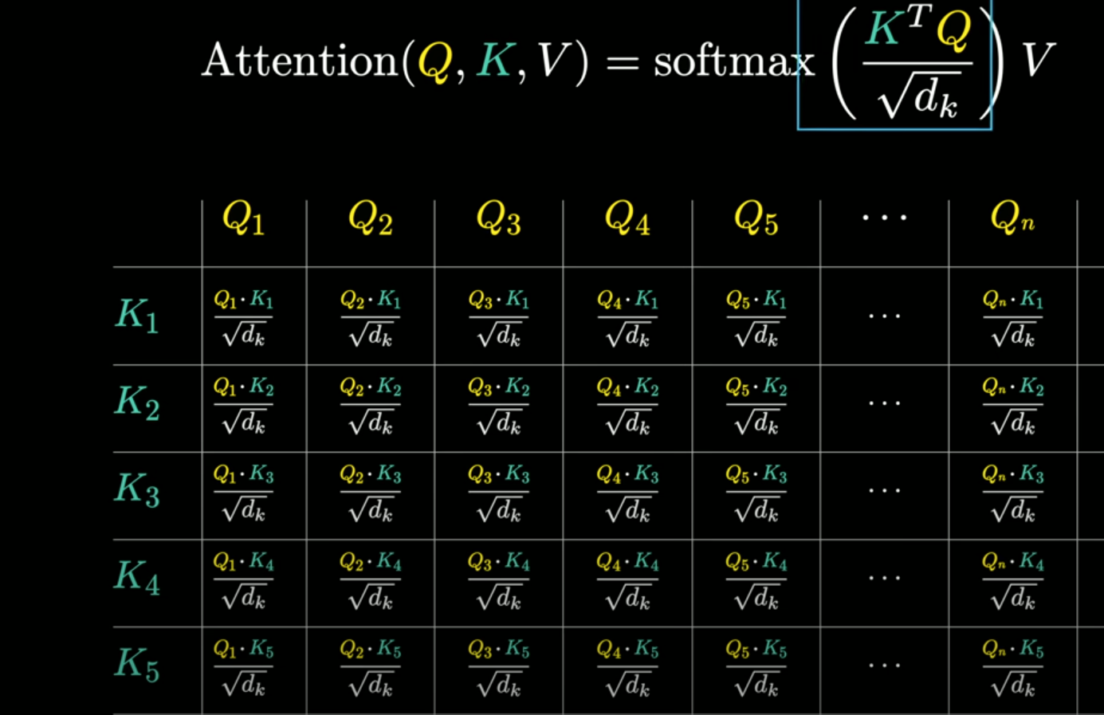

Slide 54
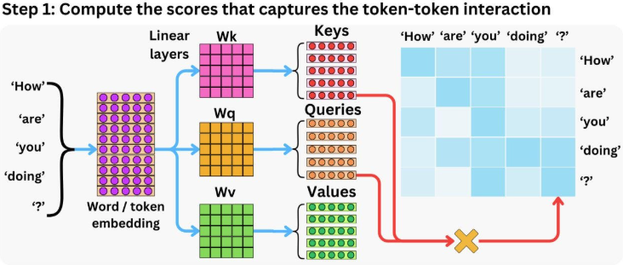

Slide 55
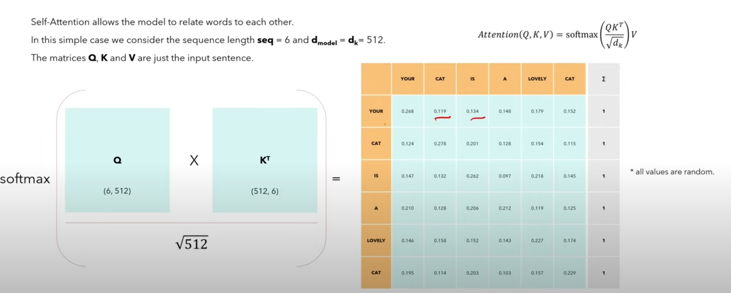
Small Example for Understanding

Slide 56
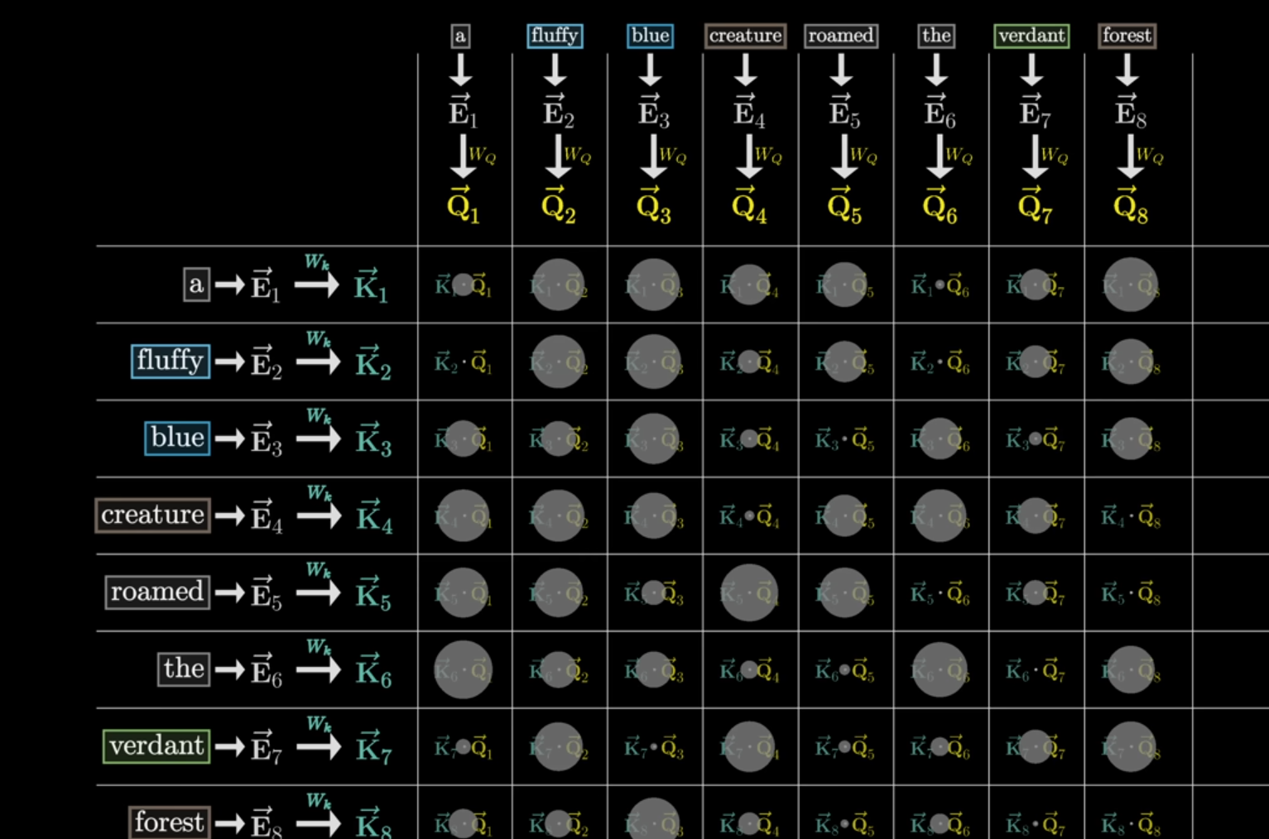

Slide 57
For each word, three vectors are computed:
The Q-matrix (Q): Think of each word in a sentence as asking a question (query) about the importance of other words. The Q matrix contains these “questions” for each word.
The K-matrix (K): The K-matrix contains the “answers” (the solution, the key) to the queries for each word. Each word has a corresponding key that helps determine how relevant it is to the query of another word.
The V-matrix (V): The V-matrix contains the actual information or features of each word. This matrix is what we use to compute the final weighted representation of each word.

Slide 58
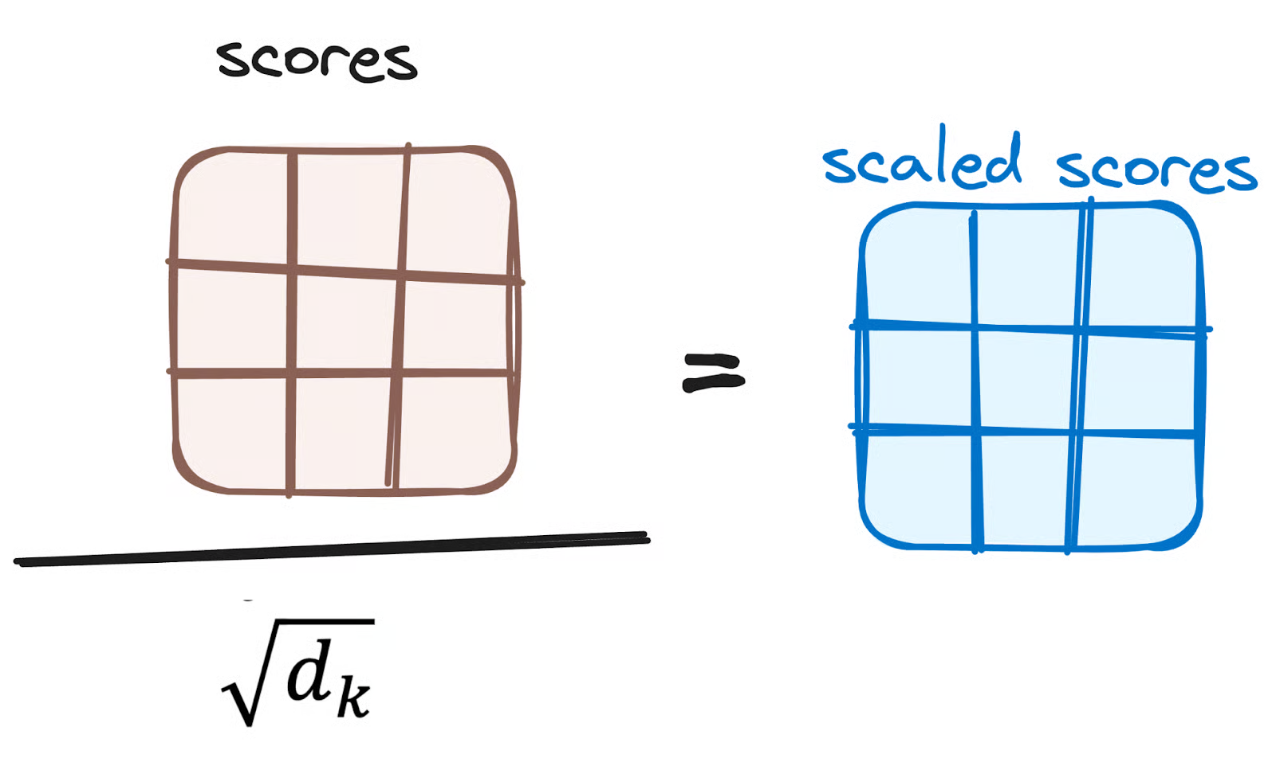
Reducing the Magnitude of attention scores
The scores are then scaled down by dividing them by the square root of the dimension of the query and key vectors. This step is implemented to ensure more stable gradients, as the multiplication of values can lead to excessively large effects.

Slide 59
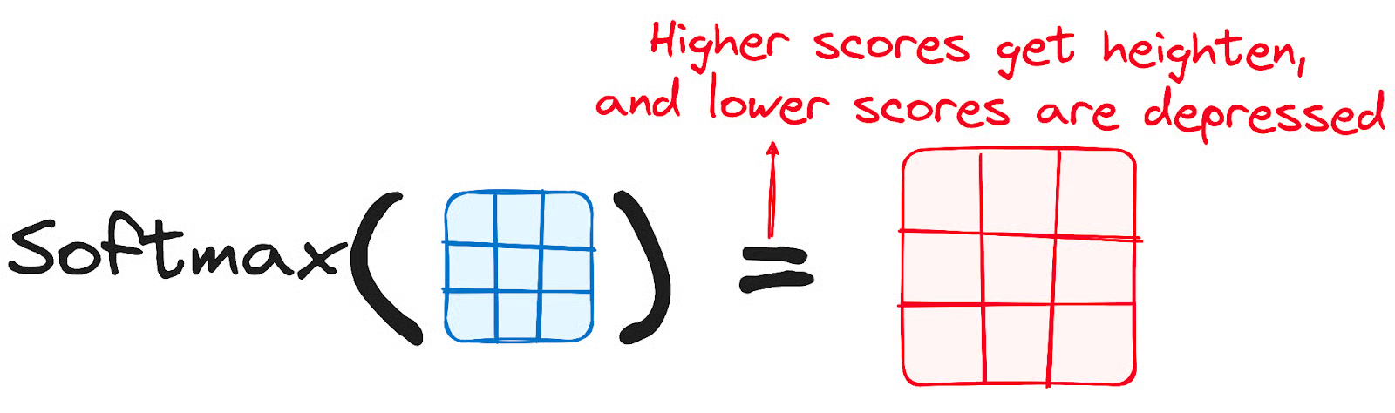
Applying Softmax to the Adjusted Scores
Subsequently, a softmax function is applied to the adjusted scores to obtain the attention weights.
This results in probability values ranging from 0 to 1.
The softmax function emphasizes higher scores while diminishing lower scores, thereby enhancing the model's ability to effectively determine which words should receive more attention.

Slide 60
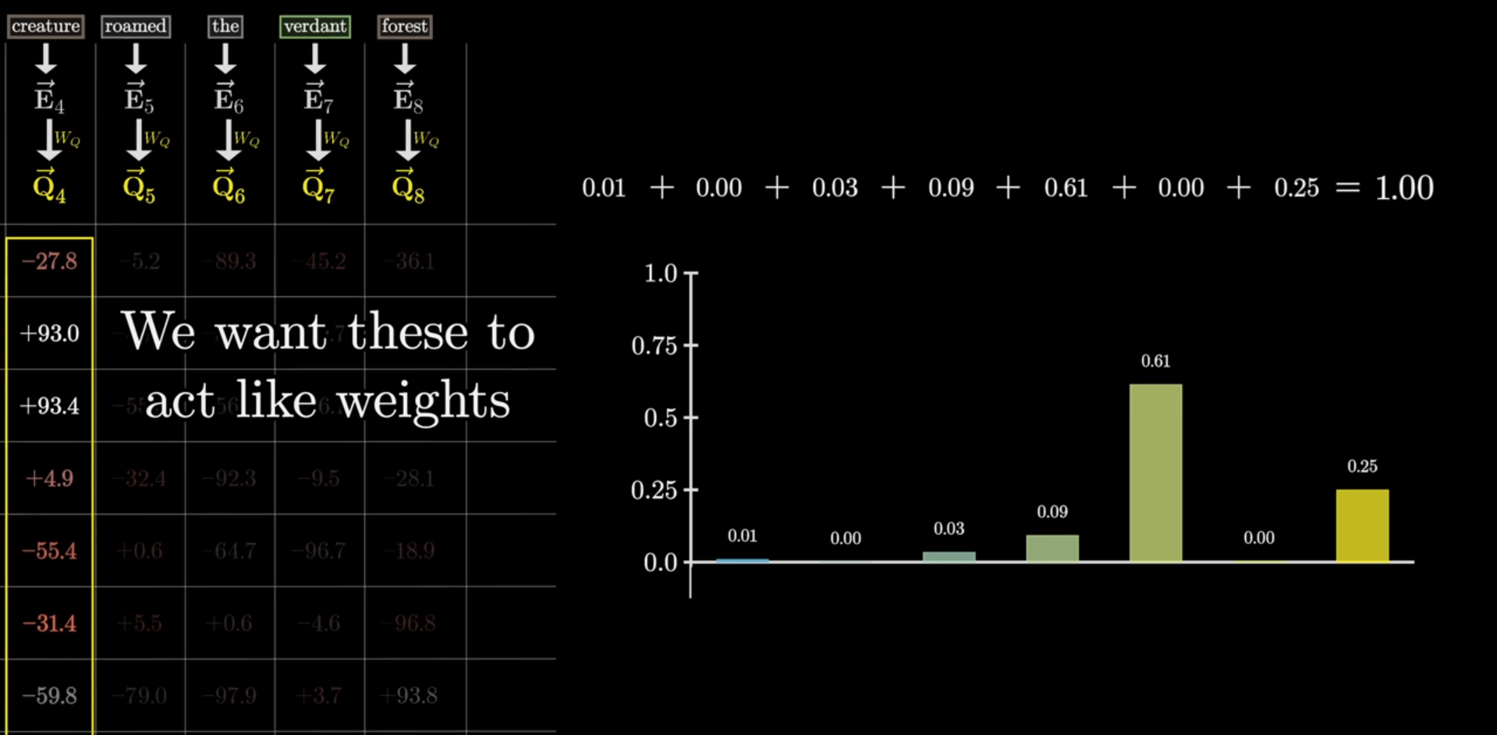

Slide 61
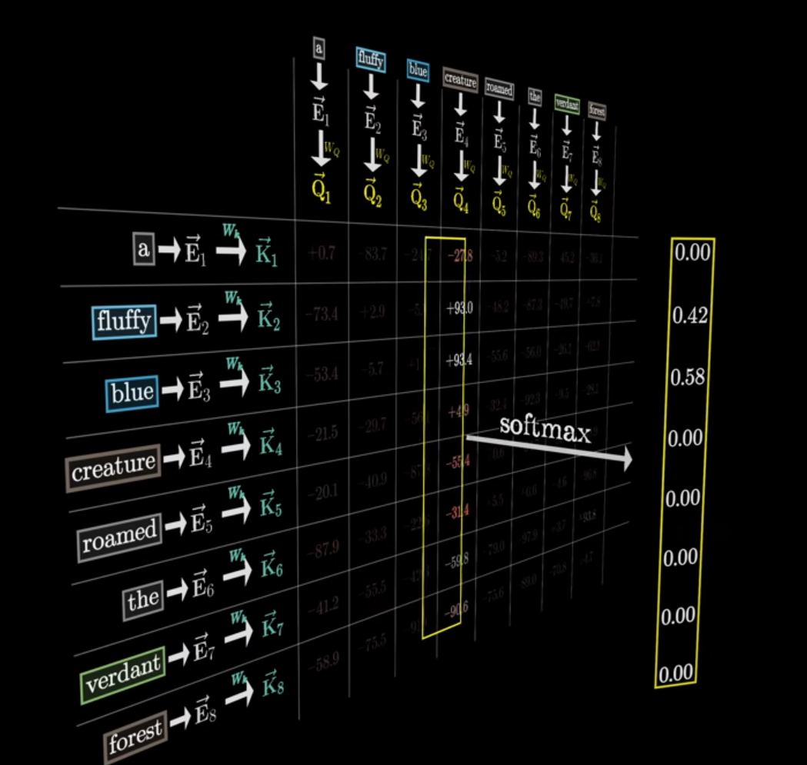
Apply softmax function

Slide 62
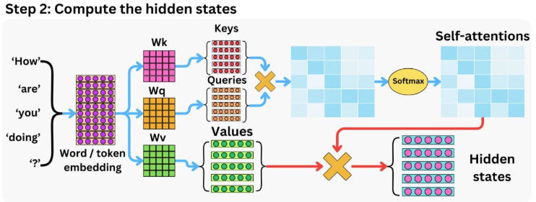

Slide 63
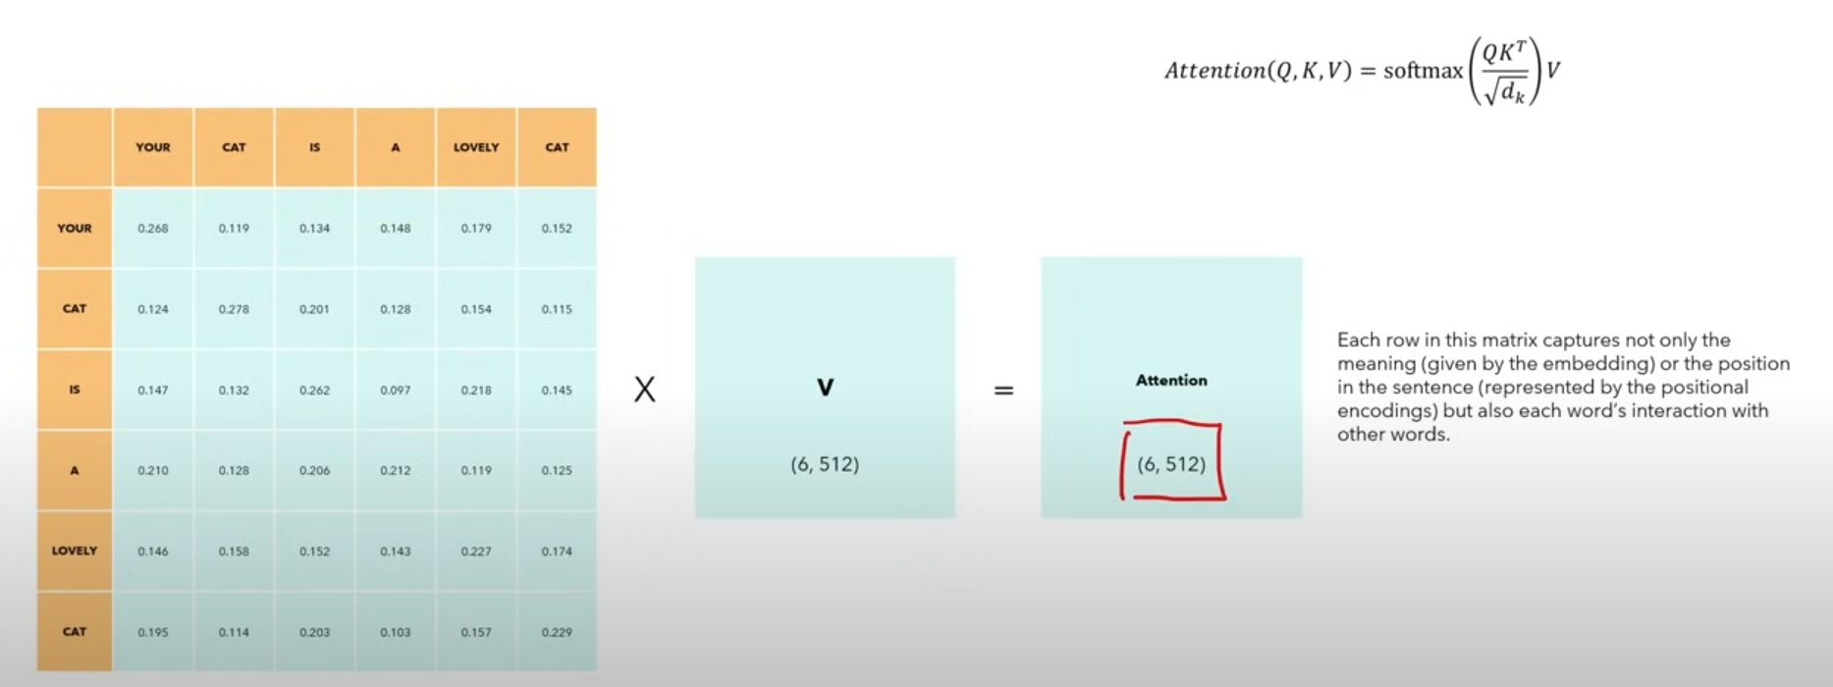
Attention weight * Value matrix

Slide 64
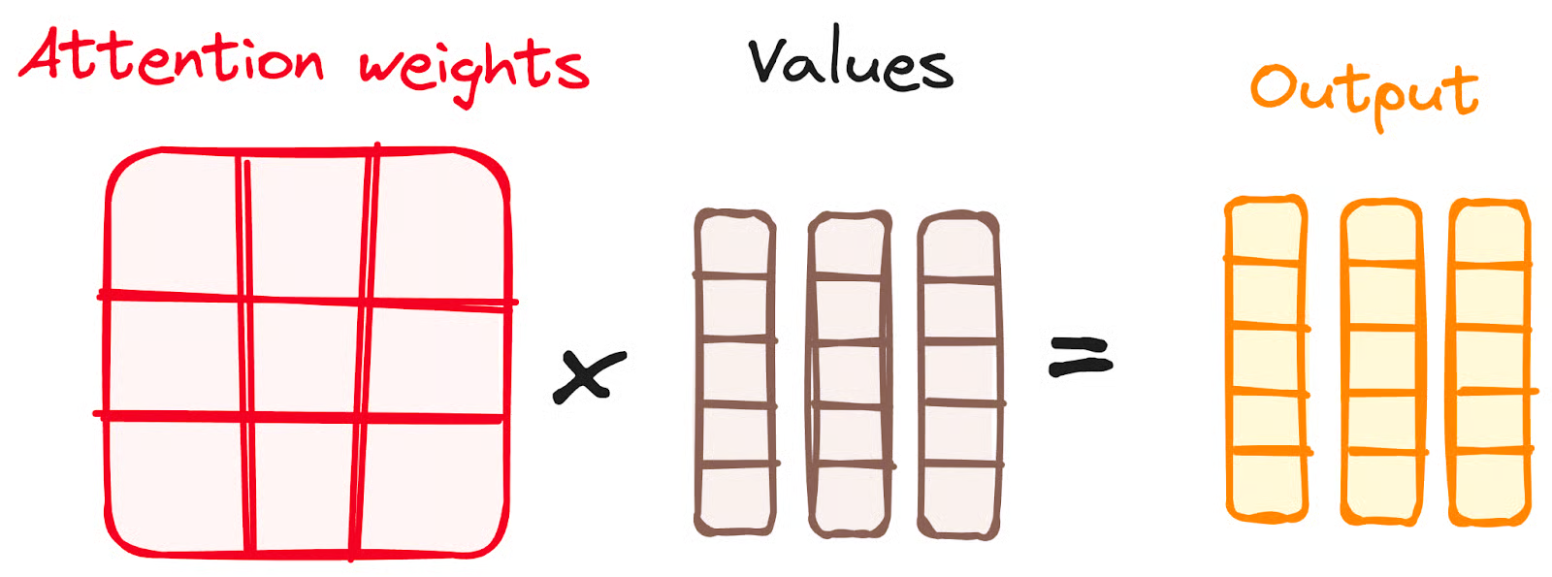
Combining Softmax Results with the Value Vector
The following step of the attention mechanism is that weights derived from the softmax function are multiplied by the value vector, resulting in an output vector.
In this process, only the words that present high softmax scores are preserved. Finally, this output vector is fed into a linear layer for further processing.
Notes:
https://www.datacamp.com/tutorial/how-transformers-work

Slide 65
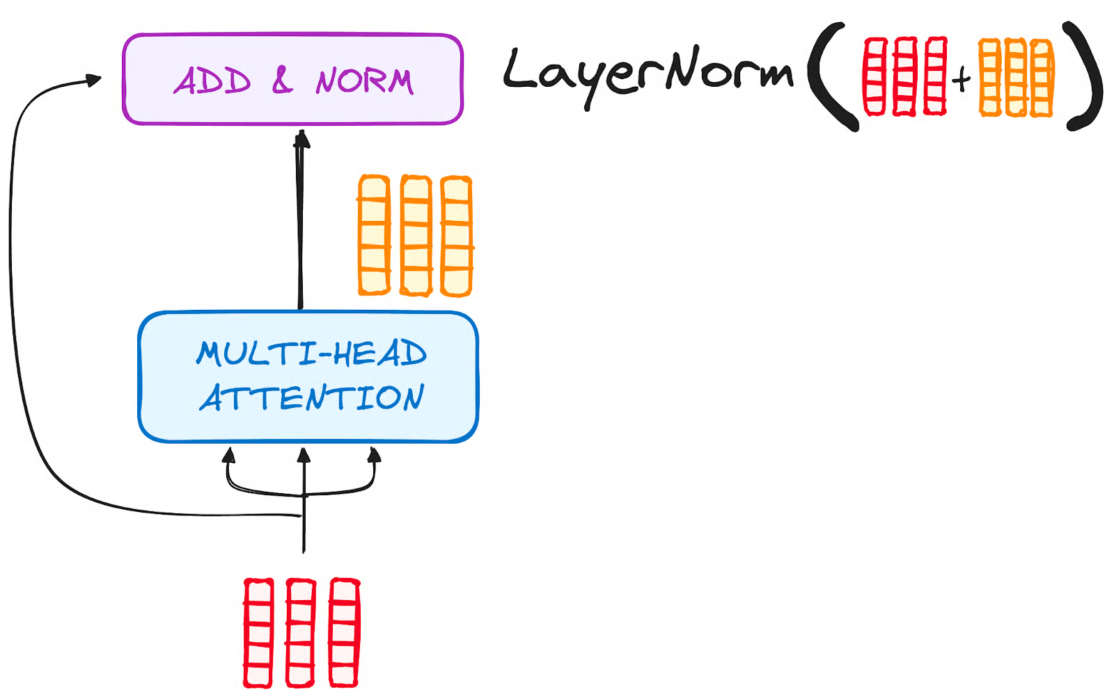
STEP 3.2 Normalization and Residual Connections
Each sub-layer in an encoder layer is followed by a normalization step. Also, each sub-layer output is added to its input (residual connection) to help mitigate the vanishing gradient problem, allowing deeper models. This process will be repeated after the Feed-Forward Neural Network too.

Slide 66
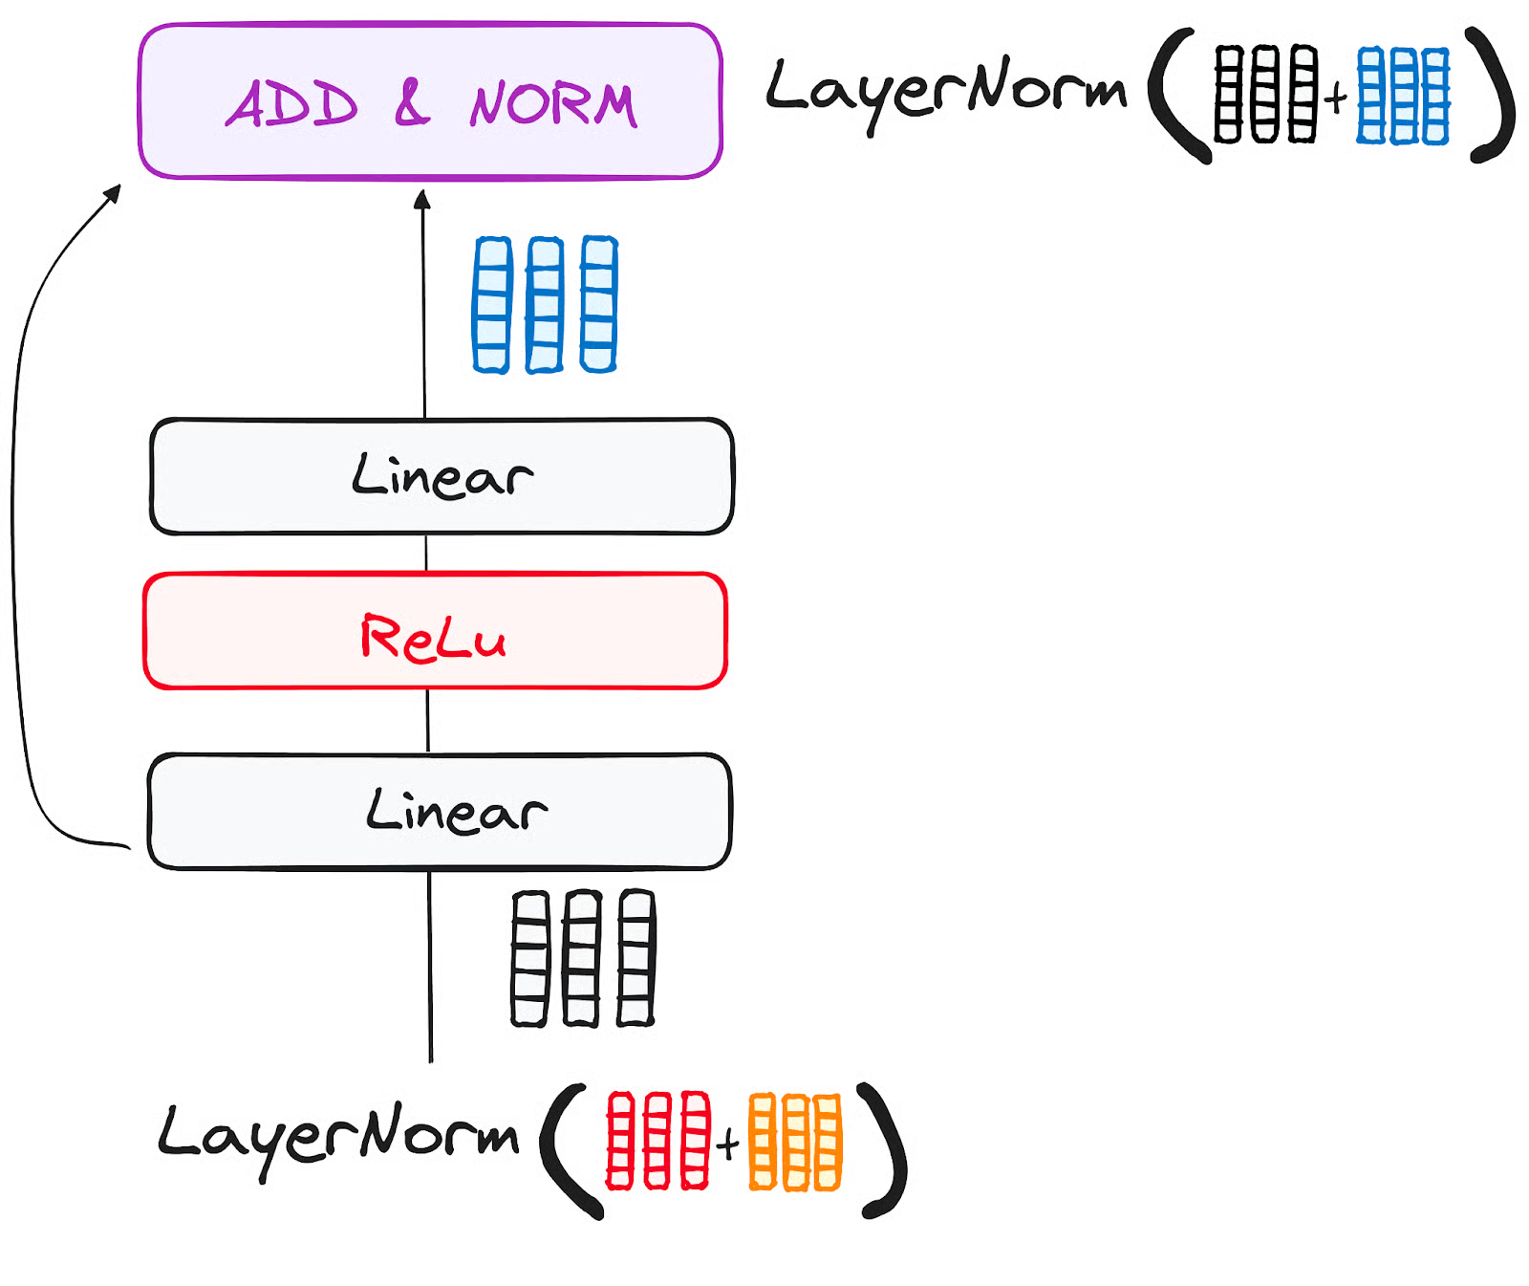
STEP 3.3 Feed-Forward Neural Network
The journey of the normalized residual output continues as it navigates through a pointwise feed-forward network, a crucial phase for additional refinement.
Picture this network as a duo of linear layers, with a ReLU activation nestled in between them, acting as a bridge. Once processed, the output embarks on a familiar path: it loops back and merges with the input of the pointwise feed-forward network.
This reunion is followed by another round of normalization, ensuring everything is well-adjusted and in sync for the next steps.

Slide 67
STEP 4 - Output of the Encoder
The output of the final encoder layer is a set of vectors, each representing the input sequence with a rich contextual understanding.
This output is then used as the input for the decoder in a Transformer model.
This careful encoding paves the way for the decoder, guiding it to pay attention to the right words in the input when it's time to decode.
Think of it like building a tower, where you can stack up N encoder layers.
Each layer in this stack gets a chance to explore and learn different facets of attention, much like layers of knowledge.
This not only diversifies the understanding but could significantly amplify the predictive capabilities of the transformer network.

Slide 68
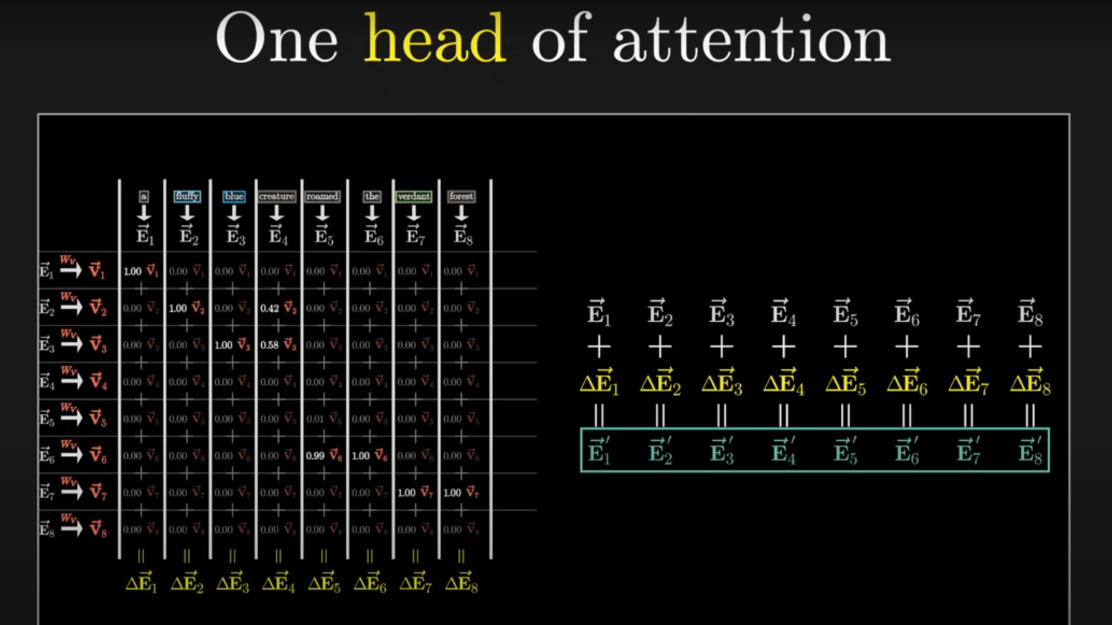

Slide 69
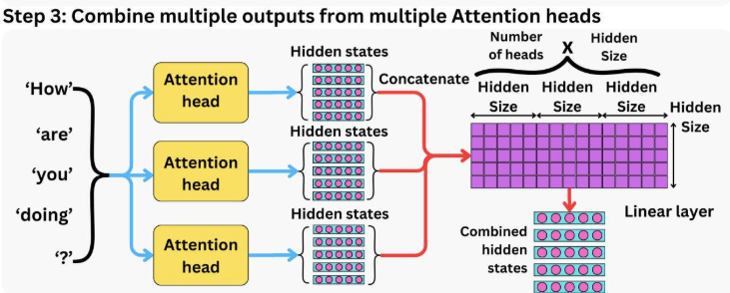
And we finally get the output of the Attention mechanism!
So, you might be wondering why it’s called Multi-Head Attention?
Remember that before all the process starts, we break our queries, keys and values h times.
This process, known as self-attention, happens separately in each of these smaller stages or 'heads'. Each head works its magic independently, conjuring up an output vector.
This ensemble passes through a final linear layer, much like a filter that fine-tunes their collective performance.
The beauty here lies in the diversity of learning across each head, enriching the encoder model with a robust and multifaceted understanding.

Slide 70
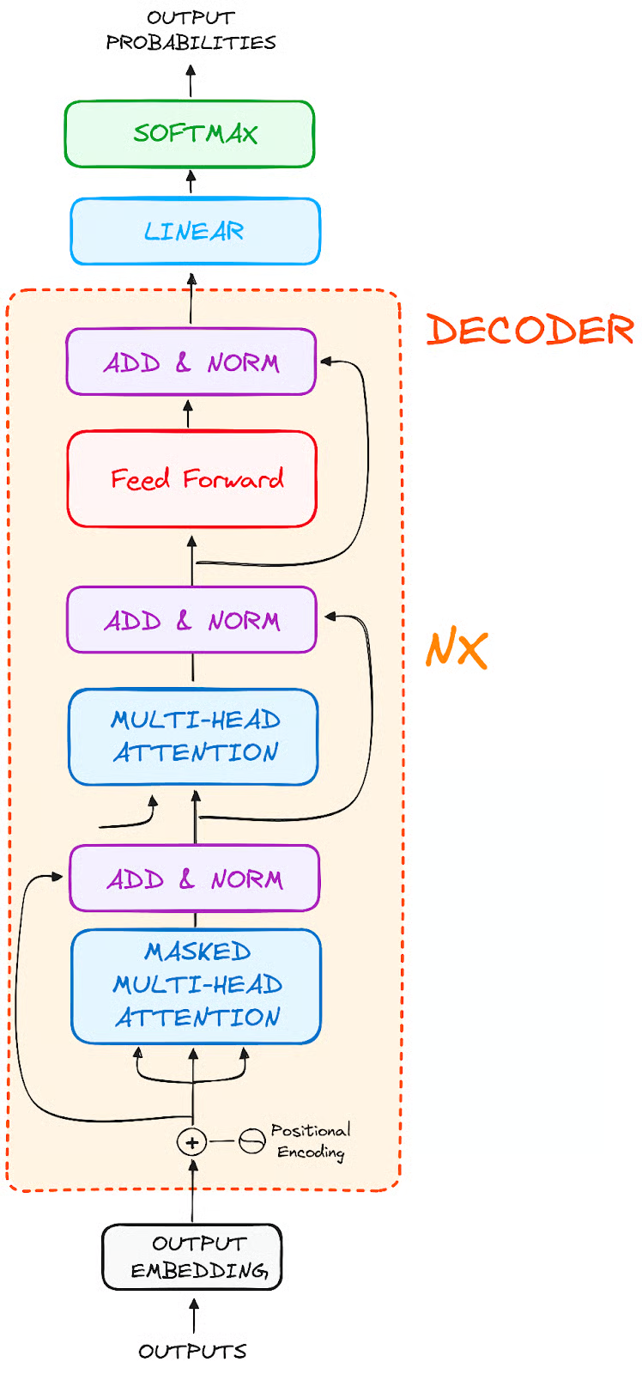
The Decoder WorkFlow
The decoder's role centers on crafting text sequences.
Mirroring the encoder, the decoder is equipped with a similar set of sub-layers.
It boasts two multi-headed attention layers, a pointwise feed-forward layer, and incorporates both residual connections and layer normalization after each sub-layer.
Notes:
https://www.datacamp.com/tutorial/how-transformers-work

Slide 71
These components function in a way akin to the encoder's layers, yet with a twist: each multi-headed attention layer in the decoder has its unique mission.
The final of the decoder's process involves a linear layer, serving as a classifier, topped off with a softmax function to calculate the probabilities of different words.
The Transformer decoder has a structure specifically designed to generate this output by decoding the encoded information step by step.
It is important to notice that the decoder operates in an autoregressive manner, kickstarting its process with a start token. It cleverly uses a list of previously generated outputs as its inputs, in tandem with the outputs from the encoder that are rich with attention information from the initial input.
This sequential dance of decoding continues until the decoder reaches a pivotal moment: the generation of a token that signals the end of its output creation.

Slide 72
Real-Life Transformer Models
BERT
LaMDA
GPT and ChatGPT

Slide 73
Explain What BERT Is
Core points:
BERT = Bidirectional Encoder Representations from Transformers.
Only encoder part of Transformer.
Uses Masked Language Modeling (MLM) + Next Sentence Prediction (NSP) for training.
Activities:
Mask words in a sentence and let students guess → then show how BERT predicts.
Example: “The cat sat on the ___.”

Slide 74
In the ever-evolving realm of Natural Language Processing (NLP), a groundbreaking innovation named BERT has emerged as a game-changer. BERT, which stands for Bidirectional Encoder Representations from Transformers, is not just another acronym in the vast sea of machine learning jargon.
It represents a shift in how machines comprehend language, enabling them to understand the intricate nuances and contextual dependencies that make human communication rich and meaningful.

Slide 75
BERT, short for Bidirectional Encoder Representations from Transformers, is a Machine Learning (ML) model for natural language processing.
It was developed in 2018 by researchers at Google AI Language and serves as a swiss army knife solution to 11+ of the most common language tasks, such as sentiment analysis and named entity recognition.

Slide 76
Why is BERT Important?
Imagine a sentence: “She plays the violin beautifully.” Traditional language models would process this sentence from left to right, missing the crucial fact that the identity of the instrument (“violin”) impacts the interpretation of the entire sentence.
BERT, however, understands that the context-driven relationship between words plays a pivotal role in deriving meaning.
It captures the essence of bidirectionality, allowing it to consider the complete context surrounding each word, revolutionizing the accuracy and depth of language understanding.

Slide 77
How does BERT work?
At its core, BERT is powered by a powerful neural network architecture known as Transformers.
This architecture incorporates a mechanism called self-attention, allowing BERT to weigh the significance of each word based on its context, both preceding and succeeding.
This context-awareness imbues BERT with the ability to generate contextualized word embeddings, which are representations of words considering their meanings within sentences.
It’s akin to BERT reading and re-reading the sentence to gain a deep understanding of every word’s role.

Slide 78
Consider the sentence: “The ‘lead’ singer will ‘lead’ the band.” Traditional models might struggle with the ambiguity of the word “lead.” BERT, however, effortlessly distinguishes that the first “lead” is a noun, while the second is a verb, showcasing its prowess in disambiguating language constructs.
In the chapters to come, we will embark on a journey that demystifies BERT, taking you from its foundational concepts to its advanced applications. You’ll explore how BERT is harnessed for various NLP tasks, learn about its attention mechanism, delve into its training process, and witness its impact on reshaping the NLP landscape.

Slide 79
As we delve into the intricacies of BERT, you’ll find that it’s not just a model; it’s a paradigm shift in how machines comprehend the essence of human language. So, fasten your seatbelts as we embark on this enlightening expedition into the world of BERT, where language understanding transcends the ordinary and achieves the extraordinary.

Slide 80
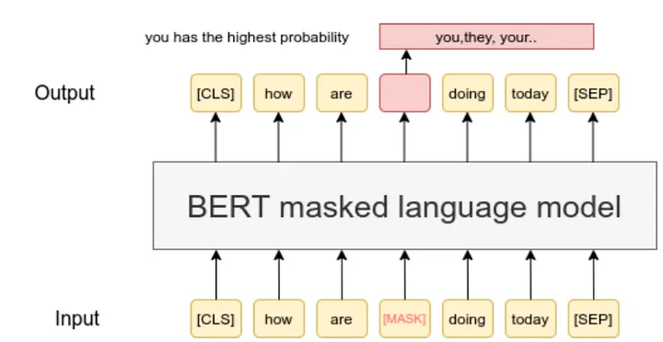
Preprocessing Text for BERT

Slide 81
Before BERT can work its magic on text, it needs to be prepared and structured in a way that it can understand. In this chapter, we’ll explore the crucial steps of preprocessing text for BERT, including tokenization, input formatting, and the Masked Language Model (MLM) objective.

Slide 82
Tokenization: Breaking Text into Meaningful Chunks
Imagine you’re teaching BERT to read a book. You wouldn’t hand in the entire book at once; you’d break it into sentences and paragraphs. Similarly, BERT needs text to be broken down into smaller units called tokens. But here’s the twist: BERT uses WordPiece tokenization. It splits words into smaller pieces, like turning “running” into “run” and “ning.” This helps handle tricky words and ensures that BERT doesn’t get lost in unfamiliar words.
Example: Original Text: “ChatGPT is fascinating.” WordPiece Tokens: [“Chat”, “##G”, “##PT”, “is”, “fascinating”, “.”]

Slide 83
Input Formatting: Giving BERT the Context
BERT loves context, and we need to serve it to him on a platter. To do that, we format the tokens in a way that BERT understands. We add special tokens like [CLS] (stands for classification) at the beginning and [SEP] (stands for separation) between sentences. As Shown in the Figure (Machine Language Model). We also assign segment embeddings to tell BERT which tokens belong to which sentence.
Example: Original Text: “ChatGPT is fascinating.” Formatted Tokens: [“[CLS]”, “Chat”, “##G”, “##PT”, “is”, “fascinating”, “.”, “[SEP]”]

Slide 84
Masked Language Model (MLM) Objective: Teaching BERT Context
BERT’s secret sauce lies in its ability to understand the bidirectional context. During its training, some words are masked (replaced with [MASK]) in sentences, and BERT learns to predict those words from their context. This helps BERT grasp how words relate to each other, both before and after. As Shown in the Figure (Machine Language Model)
Example: Original Sentence: “The cat is on the mat.” Masked Sentence: “The [MASK] is on the mat.”
from transformers import BertTokenizer
tokenizer = BertTokenizer.from_pretrained('bert-base-uncased')
text = "BERT preprocessing is essential."
tokens = tokenizer.tokenize(text)
print(tokens)

Slide 85
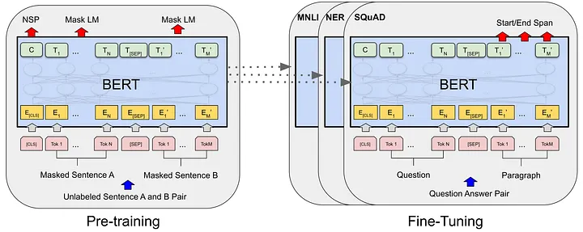
Fine-Tuning BERT for Specific Tasks

Slide 86
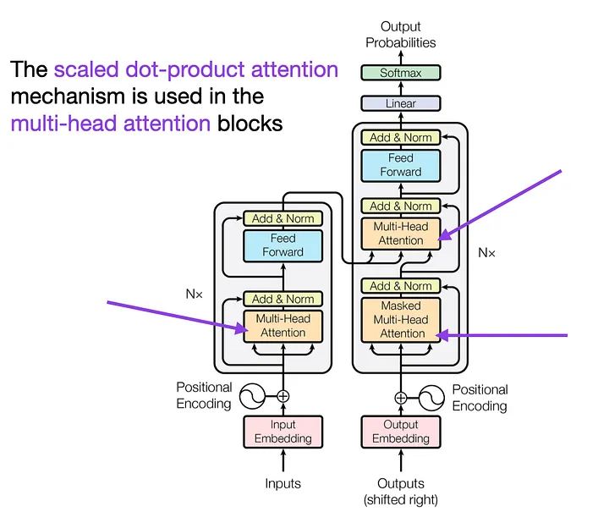
BERT’s Attention Mechanism
Now that we’ve seen how to apply BERT to tasks, let’s dig deeper into what makes BERT so powerful — its attention mechanism. In this chapter, we’ll explore self-attention, multi-head attention, and how BERT’s attention mechanism allows it to grasp the context of language.

Slide 87
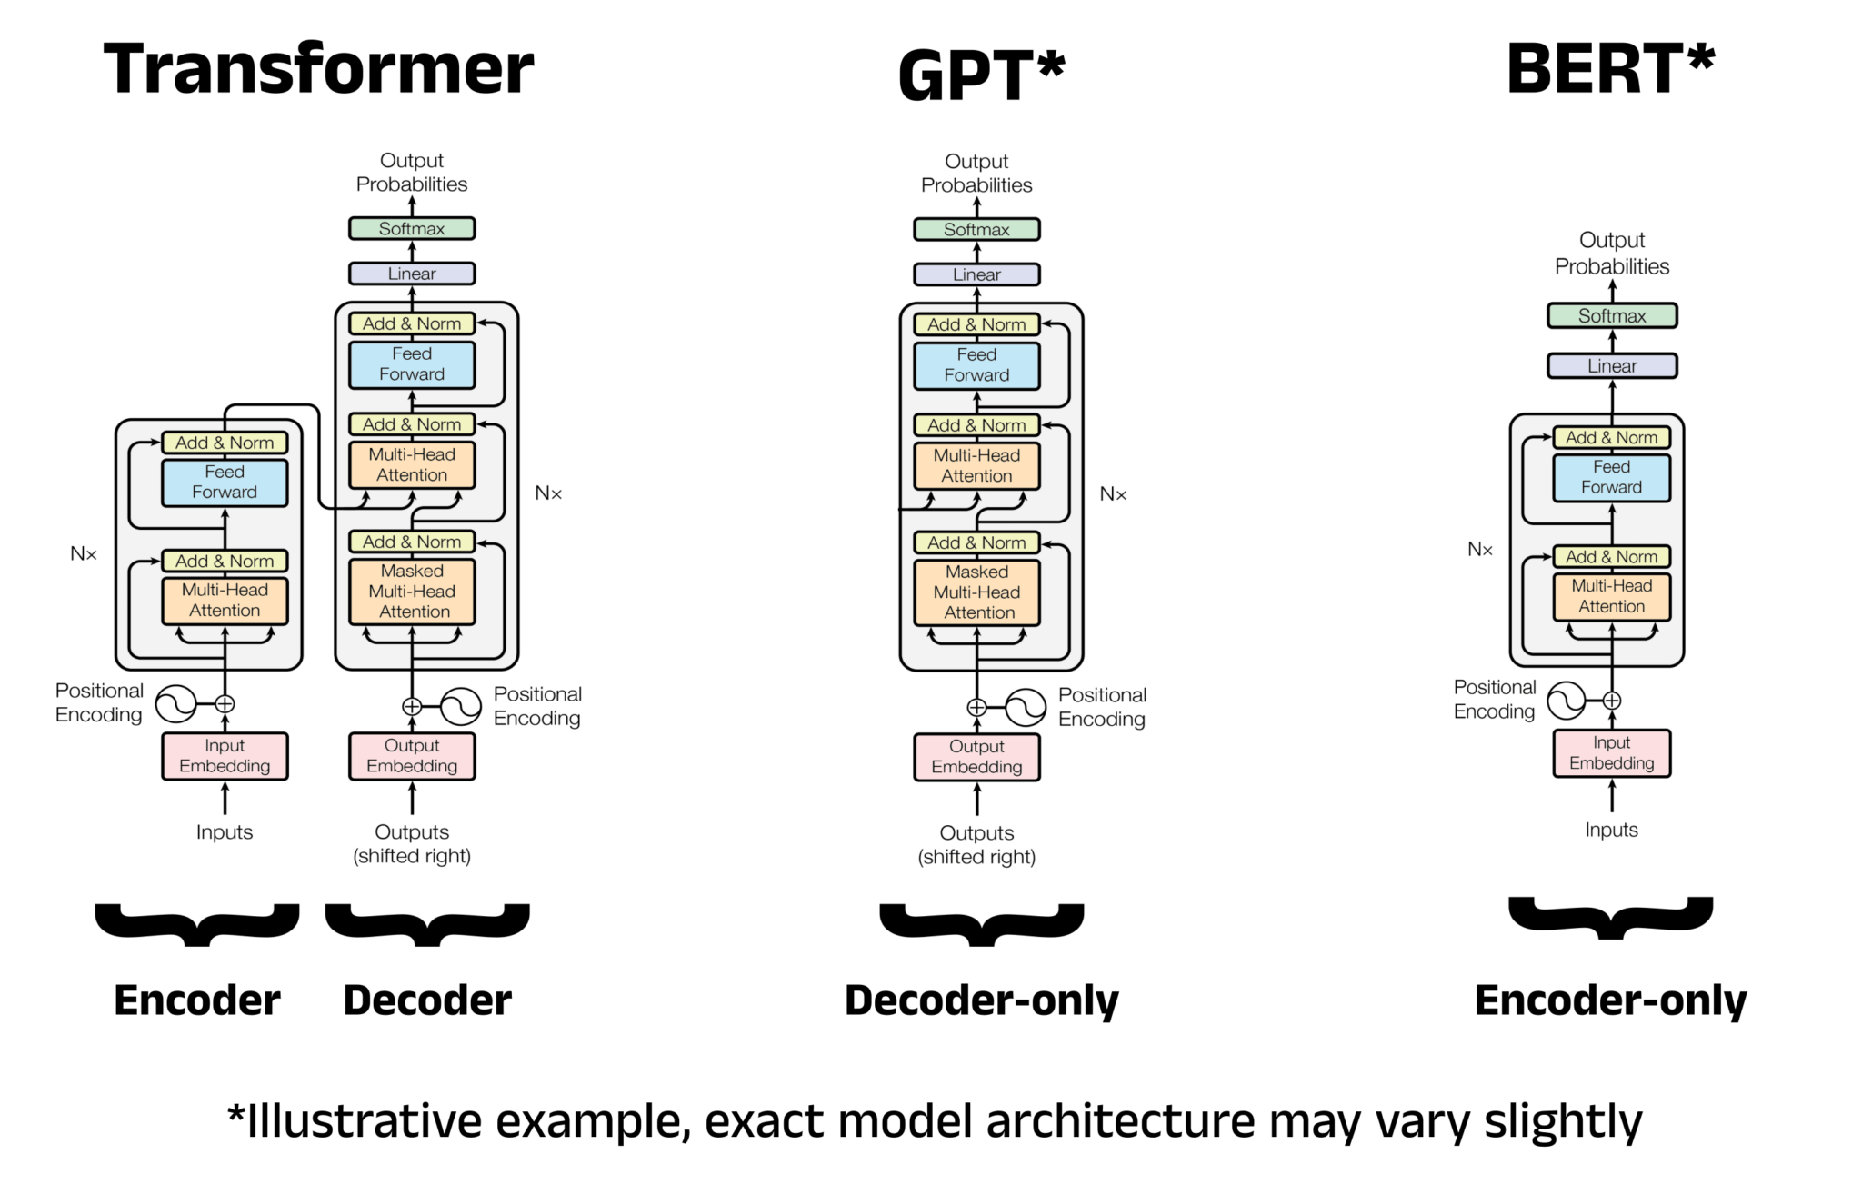
Notes:
https://towardsdatascience.com/a-complete-guide-to-bert-with-code-9f87602e4a11/

Slide 88
Self-Attention: BERT’s Superpower
Imagine reading a book and highlighting the words that seem most important to you. Self-attention is like that, but for BERT. It looks at each word in a sentence and decides how much attention it should give to other words based on their importance. This way, BERT can focus on relevant words, even if they’re far apart in the sentence.

Slide 89
Multi-Head Attention: The Teamwork Trick
BERT doesn’t rely on just one perspective; it uses multiple “heads” of attention. Think of these heads as different experts focusing on various aspects of the sentence. This multi-head approach helps BERT capture different relationships between words, making its understanding richer and more accurate.

Slide 90
Attention in BERT: The Contextual Magic
BERT’s attention isn’t limited to just the words before or after a word. It considers both directions! When BERT reads a word, it’s not alone; it’s aware of its neighbors. This way, BERT generates embeddings that consider the entire context of a word. It’s like understanding a joke not just by the punchline but also by the setup.

Slide 91
In this code, we visualize BERT’s attention weights using Hugging Face Transformers. These weights show how much attention BERT pays to different words in the sentence.
BERT’s attention mechanism is like a spotlight, helping it focus on what matters most in a sentence. In the next chapter, we’ll delve into BERT’s training process and how it becomes the language maestro it is. Stay tuned for more insights!
import torch
from transformers import BertModel, BertTokenizer
tokenizer = BertTokenizer.from_pretrained('bert-base-uncased')
model = BertModel.from_pretrained('bert-base-uncased')
text = "BERT's attention mechanism is fascinating."
inputs = tokenizer(text, return_tensors='pt', padding=True, truncation=True)
outputs = model(**inputs, output_attentions=True)
attention_weights = outputs.attentions
print(attention_weights)

Slide 92
BERT’s Training Process
Understanding how BERT learns is key to appreciating its capabilities. In this chapter, we’ll uncover the intricacies of BERT’s training process, including its pretraining phase, the Masked Language Model (MLM) objective, and the Next Sentence Prediction (NSP) objective.
Notes:
https://medium.com/@shaikhrayyan123/a-comprehensive-guide-to-understanding-bert-from-beginners-to-advanced-2379699e2b51

Slide 93
Pretraining Phase: The Knowledge Foundation
BERT’s journey begins with pretraining, where it learns from an enormous amount of text data. Imagine showing BERT millions of sentences and letting it predict missing words. This exercise helps BERT build a solid understanding of language patterns and relationships.

Slide 94
Masked Language Model (MLM) Objective: The Fill-in-the-Blanks Game
During pretraining, BERT is given sentences with some words masked (hidden). It then tries to predict those masked words based on the surrounding context. This is like a language version of the fill-in-the-blanks game. By guessing the missing words, BERT learns how words relate to each other, achieving its contextual brilliance.

Slide 95
Next Sentence Prediction (NSP) Objective: Grasping Sentence Flow
BERT doesn’t just understand words; it grasps the flow of sentences. In the NSP objective, BERT is trained to predict if one sentence follows another in a text pair. This helps BERT comprehend the logical connections between sentences, making it a master at understanding paragraphs and longer texts.

Slide 96
Example: Pretraining and MLM
from transformers import BertForMaskedLM, BertTokenizer
import torch
tokenizer = BertTokenizer.from_pretrained('bert-base-uncased')
model = BertForMaskedLM.from_pretrained('bert-base-uncased')
text = "BERT is a powerful language model."
inputs = tokenizer(text, return_tensors='pt', padding=True, truncation=True, add_special_tokens=True)
outputs = model(**inputs, labels=inputs['input_ids'])
loss = outputs.loss
print(loss)

Slide 97
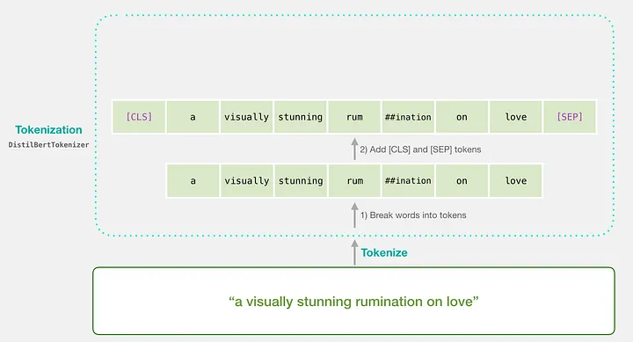
BERT Embeddings
BERT’s power lies in its ability to represent words in a way that captures their meaning within a specific context.
In this chapter, we’ll unravel BERT’s embeddings, including its contextual word embeddings, WordPiece tokenization, and positional encodings.

Slide 98
Word Embeddings vs. Contextual Word Embeddings
Think of word embeddings as code words for words. BERT takes this a step further with contextual word embeddings. Instead of just having one code word for each word, BERT creates different embeddings for the same word based on its context in a sentence. This way, each word’s representation is more nuanced and informed by the surrounding words.

Slide 99
WordPiece Tokenization: Handling Complex Vocabulary
BERT’s vocabulary is like a puzzle made of smaller pieces called subwords. It uses WordPiece tokenization to break down words into these subwords.
This is particularly useful for handling long and complex words, as well as for tackling words it hasn’t seen before.

Slide 100
Positional Encodings: Navigating Sentence Structure
Since BERT reads words in a bidirectional manner, it needs to know the position of each word in a sentence. Positional encodings are added to the embeddings to give BERT this spatial awareness. This way, BERT knows not just what words mean, but also where they belong in a sentence.
from transformers import BertTokenizer, BertModel
import torch
tokenizer = BertTokenizer.from_pretrained('bert-base-uncased')
model = BertModel.from_pretrained('bert-base-uncased')
text = "BERT embeddings are fascinating."
inputs = tokenizer(text, return_tensors='pt', padding=True, truncation=True, add_special_tokens=True)
outputs = model(**inputs)
word_embeddings = outputs.last_hidden_state
print(word_embeddings)
Extracting Word Embeddings with Hugging Face Transformers

Slide 101
This code shows how to extract word embeddings using Hugging Face Transformers. The model generates contextual embeddings for each word in the input text.
BERT’s embeddings are like a language playground where words get their unique context-based identities. In the next chapter, we’ll explore advanced techniques for fine-tuning BERT and adapting it to various tasks. Keep learning and experimenting!

Slide 102
Training Objectives in Detail
MLM:
Mask 15% of words → predict them.
Why masking works better than left-to-right prediction.
NSP:
Given two sentences, predict if the second follows the first.
Importance for sentence-level understanding (use example Q&A pairs).

Slide 103
Tokenization & Input Representation
WordPiece tokenization.
Special tokens: [CLS], [SEP], [PAD].
Embeddings: token embeddings + segment embeddings + positional embeddings.
Hands-on demo: Show how sentence → tokens → embeddings → input matrix.

Slide 104
BERT Architecture in Depth
Points:
Layers (12 in BERT-base, 24 in BERT-large).
Hidden size (768 vs 1024).
Attention heads.
Visualization: Show how input flows through stacked encoders.

Slide 105
Fine-Tuning BERT
Pretraining vs Fine-tuning.
Downstream tasks: Classification, QA, NER.
Adding task-specific layers (e.g., softmax classifier on top of [CLS]).
Demo idea: Fine-tune BERT for sentiment classification on a small dataset.

Slide 106
Strengths and Limitations
Strengths:
State-of-the-art on GLUE, SQuAD.
Bidirectional context understanding.
Limitations:
Computational cost.
Training data dependence (bias).
Not great for very long documents (512 token limit).

Slide 107
Extensions Beyond BERT
Variants: RoBERTa, DistilBERT, ALBERT, DeBERTa.
Why they exist: Efficiency, better training strategies, or specialized tasks.

Slide 108
BERT models pre-trained for specific tasks:
Twitter sentiment analysis
Analysis of Japanese text
Emotion categorizer (English - anger, fear, joy, etc.)
Clinical Notes analysis
Speech to text translation
Toxic comment detection
Notes:
https://huggingface.co/blog/bert-101

Slide 109
GPT (Generative Pre-trained Transformer)
GPT is a transformer-based model that generates context-aware embeddings by processing text in a unidirectional manner (left-to-right).
GPT uses the decoder part of the transformer, to process the input text. The model consists of multiple layers of self-attention mechanisms, which allow it to capture dependencies between words in a sentence. This allows GPT to excel in tasks that involve language generation, such as text completion, dialogue generation, and more. The model is pre-trained on a large corpus of text and can be fine-tuned for specific tasks.
Pros: Effective for language generation, Fine-tuning capability.
Cons: Unidirectional context, Resource Intensive, Context Length Limitation.
from transformers import GPT2Tokenizer, GPT2Model
import torch
# Load pre-trained GPT-2 model and tokenizer
tokenizer = GPT2Tokenizer.from_pretrained('gpt2')
model = GPT2Model.from_pretrained('gpt2')
# Sample data
sentence = "This is the first document."
# Tokenize input
inputs = tokenizer(sentence, return_tensors='pt')
# Get embeddings
with torch.no_grad():
outputs = model(**inputs)
embeddings = outputs.last_hidden_state
print(embeddings)
Notes:
https://medium.com/@harsh.vardhan7695/a-comprehensive-guide-to-word-embeddings-in-nlp-ee3f9e4663ed

Slide 110
Introduction to RAG
Retrieval Augmented Generation (RAG)
https://www.youtube.com/watch?v=sVcwVQRHIc8
https://www.youtube.com/watch?v=_HQ2H_0Ayy0

Slide 111
Introduction of RAG
Retrieval-Augmented Generation (RAG) is the process of optimizing the output of a large language model, so it references an authoritative knowledge base outside of its training data sources before generating a response.
“Large Language Models (LLMs) are trained on vast volumes of data and use billions of parameters to generate original output for tasks like answering questions, translating languages, and completing sentences.”
RAG extends the already powerful capabilities of LLMs to specific domains or an organization's internal knowledge base, all without the need to retrain the model.
It is a cost-effective approach to improving LLM output so it remains relevant, accurate, and useful in various contexts.

Slide 112
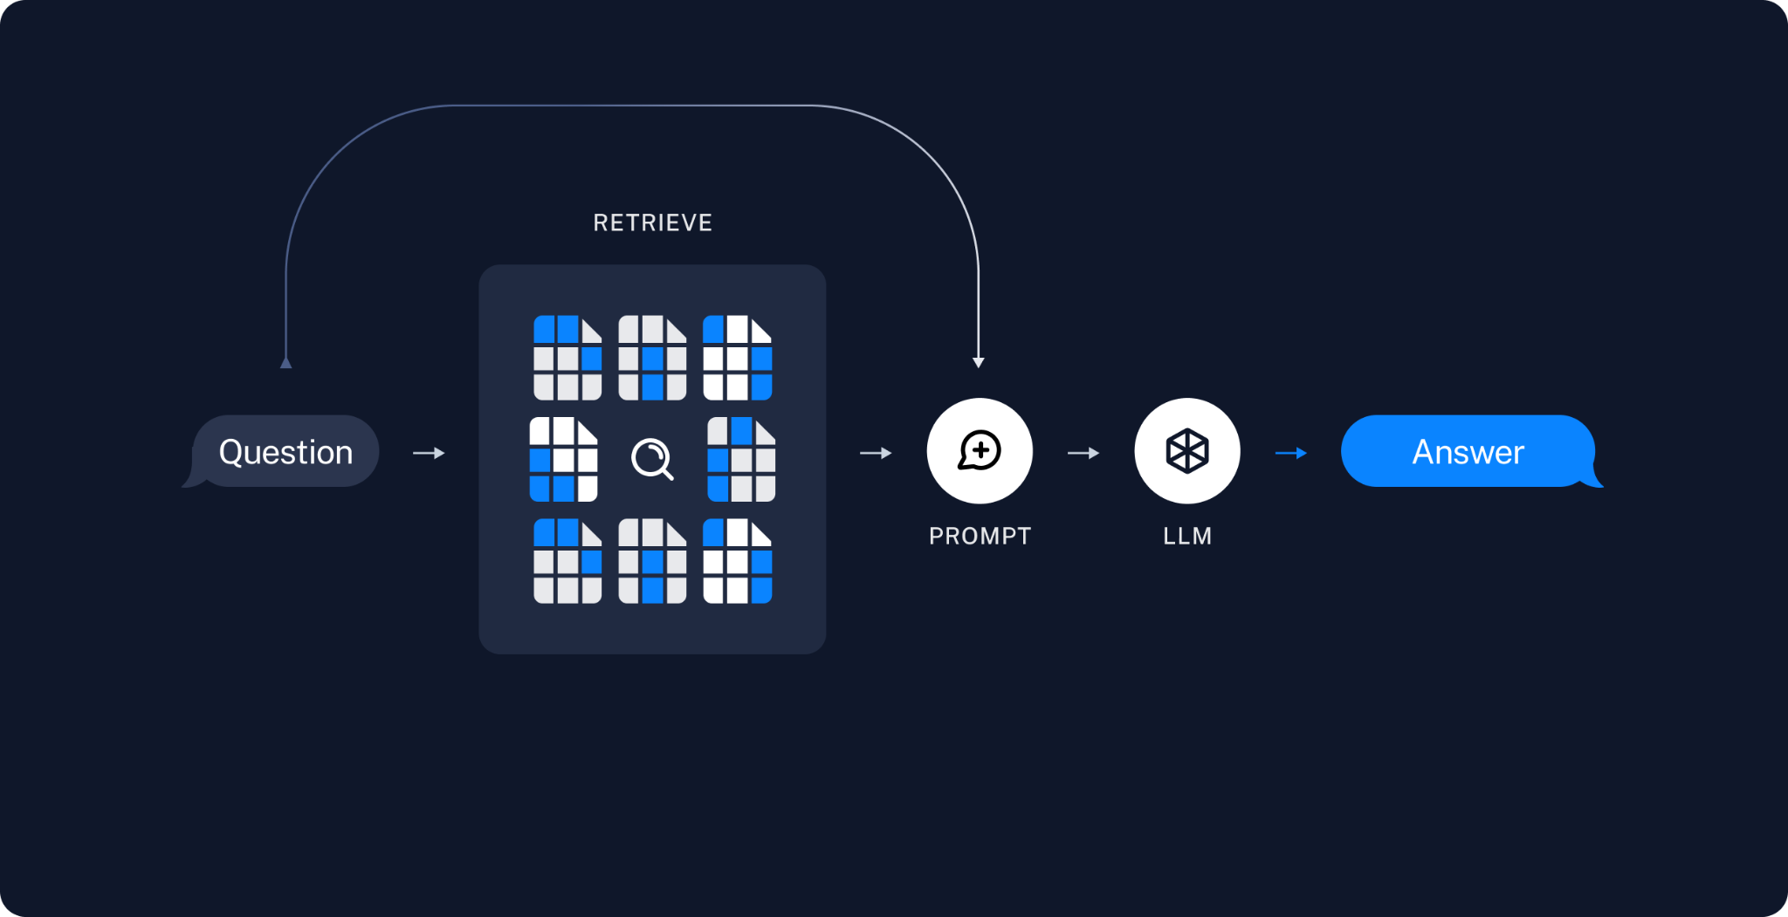

Slide 113

Why do we need RAG?
Before we dive into how RAG works, we have to ask ourselves why we need RAG in the first place.
The main problem with Large Language Models (LLMs) is that these models are essentially probabilistic models and what they basically do is predict one word at a time based on probability.
These models use an autoregressive approach, where they take the previous words as context and then predict the most likely next word.
Also, these ‘next’ words come from the huge corpus on which these models are trained.
So, when you’re trying to solve a very specific problem that is out of the scope of its training data, these models start to hallucinate.

Slide 114
RAG
Now, it’s easy to deal with this issue. We just have to provide the LLM with the context required to solve our specific problem.
It could be anything from a bunch of PDFs (e.g., return policies for an e-commerce platform if you intend to build a RAG-based Chatbot or AI Agent) to websites (i.e., scraping is required; beautifulsoup4 comes in handy in such cases) or all sorts of parsable files.
But there’s an issue with the context window.

Slide 115
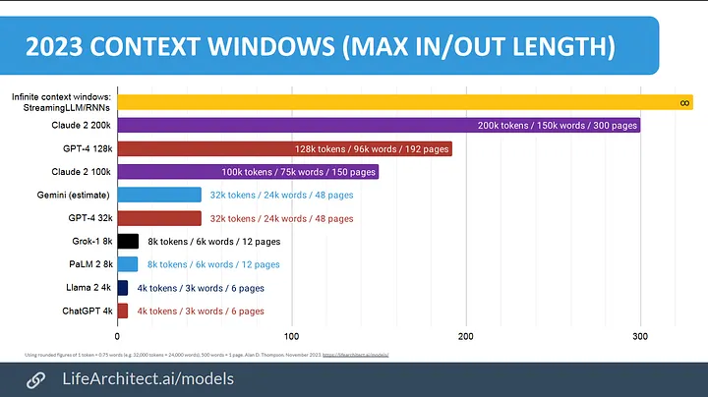
So, what is a context window? A context window refers to the amount of text data a language model can consider at one time when generating responses. It includes all the tokens from the input text that the model looks at to gather context before replying. The size of this window directly influences the model’s understanding and response accuracy.
That’s why attaching a bunch of PDFs or DOCXs to generate coherent responses is neither sensible nor scalable. This is where RAG comes into the picture.

Slide 116
RAG + langchain
By integrating retrieval mechanisms into the generation process, RAG allows models to access external knowledge sources, significantly enhancing the quality, coherence, and relevance of generated text.
Complementing RAG's capabilities is LangChain, which expands the scope of accessible knowledge and enhances context-aware reasoning in text generation.
Together, RAG and LangChain form a powerful duo in NLP, pushing the boundaries of language understanding and generation.
This synergy not only improves performance but also offers unprecedented potential for advancing state-of-the-art applications in the field.

Slide 117
Why RAG? (Problem)
What is RAG?
LLMs are powerful but:
Outdated knowledge
Hallucinations
Domain-specific gaps
Retrieval → fetch info from external knowledge
Augmentation → enrich user query with retrieved data
Generation → LLM produces grounded answers

Slide 118
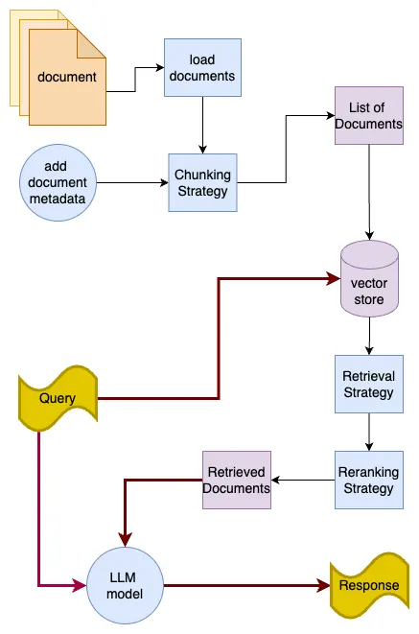
RAG Pipeline
Index documents (embed & store)
Retrieve relevant chunks
Generate response with LLM
Key advantages:
Keeps LLMs up-to-date.
Reduces hallucinations.
Domain-specific QA (finance, legal, medical).

Slide 119


Slide 120
Embeddings → convert text into vectors.
Vector Database → store and search embeddings (FAISS, Chroma, Pinecone).
Retriever → finds relevant chunks.
LLM → generates answer with retrieved context.
Keep it simple with 3 steps: Index → Retrieve → Generate.

Slide 121
Introducing Langchain
LangChain is a framework that simplifies building applications with LLMs by providing modular components and abstractions.
For RAG (Retrieval Augmented Generation) pipelines specifically, it offers pre-built components for document loading, text chunking, vector storage, and retrieval — allowing us, the developers, to quickly set up a working system without having to implement these pieces from scratch.

Slide 122
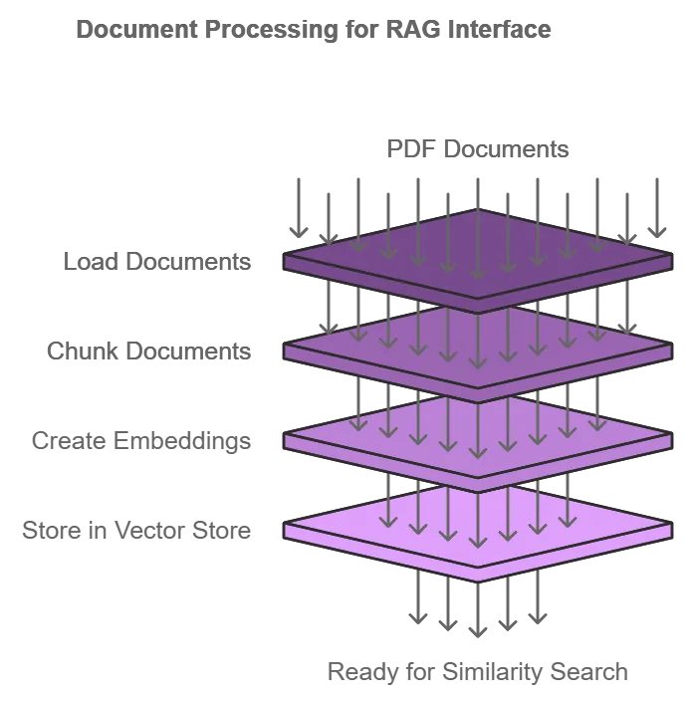
Data Ingestion
The flow is simple — we’ll take a bunch of PDFs, put ’em all in a directory, load ’em in our script, chunk ‘em in pieces, create embeddings, and lastly, store the documents and their embeddings in a vector store e.g.
Chroma/FAISS so that we’ll be able to perform some similarity search in the future.
Notes:
https://sougaaat.medium.com/end-to-end-implementation-of-a-rag-pipeline-using-langchain-v0-3-8691690368a3

Slide 123
Notes:
https://blog.futuresmart.ai/master-rag-with-langchain-a-practical-guide

Slide 124
Notes:
https://medium.com/@pinaki.brahma/create-your-first-rag-pipeline-using-langchain-a-handholding-tutorial-for-beginners-0310af4de20c

